Slide 1
Maps to Edit

Slide 2
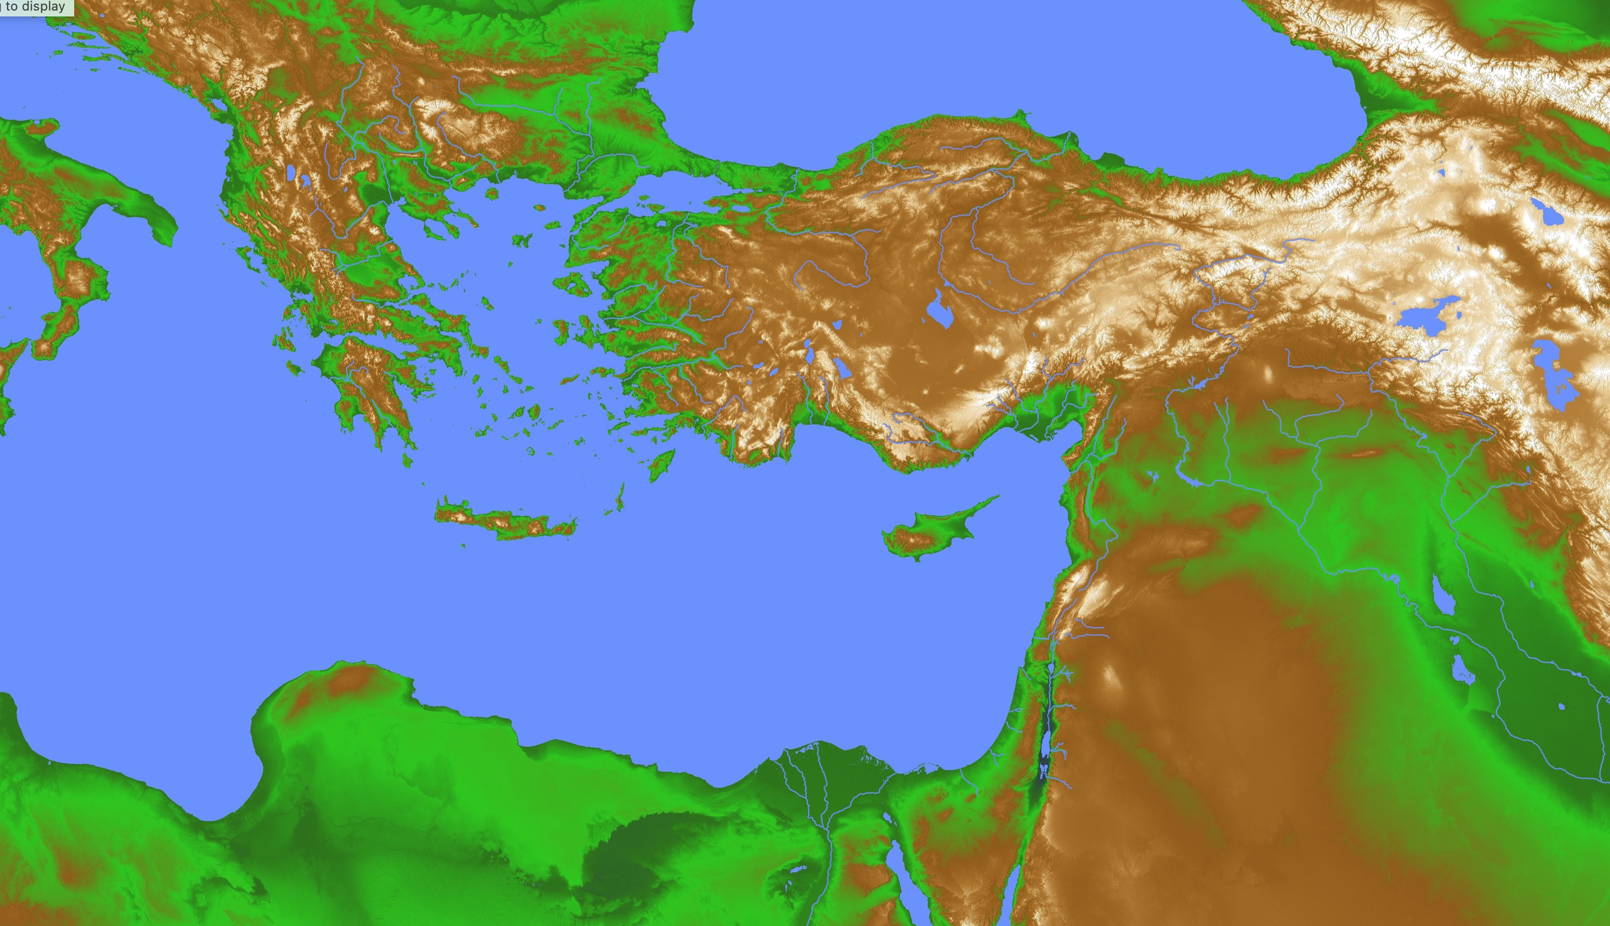
Greek & Persian Loan Words in Daniel
28
Greece
Persia
"Then a herald shouted out, 'People of all races and nations and languages, listen to the king’s command! ⁵ When you hear the sound of the horn, flute, zither, lyre, harp, pipes, and other musical instruments, bow to the ground to worship King Nebuchadnezzar’s gold statue. ⁶ Anyone who refuses to obey will immediately be thrown into a blazing furnace'" (Daniel 3:4-6 NLT).
—How do we explain these many Greek and Persian words in 600 BC before the Greek and Roman empires were established?
Babylon

Slide 3
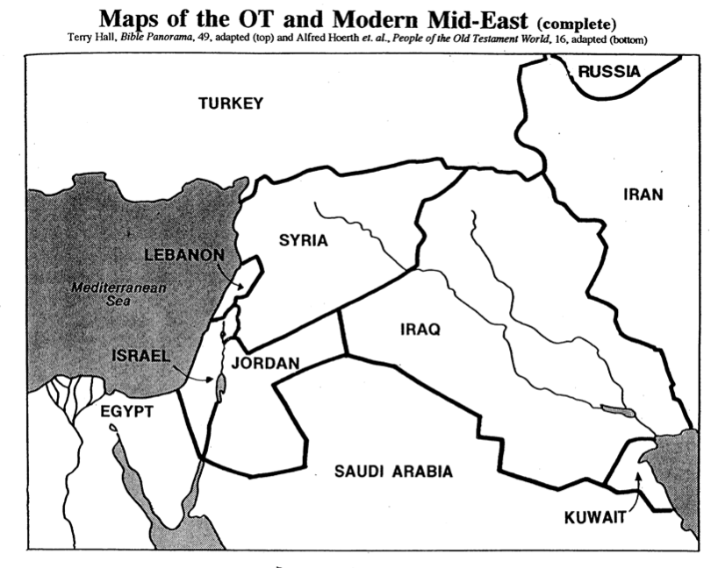
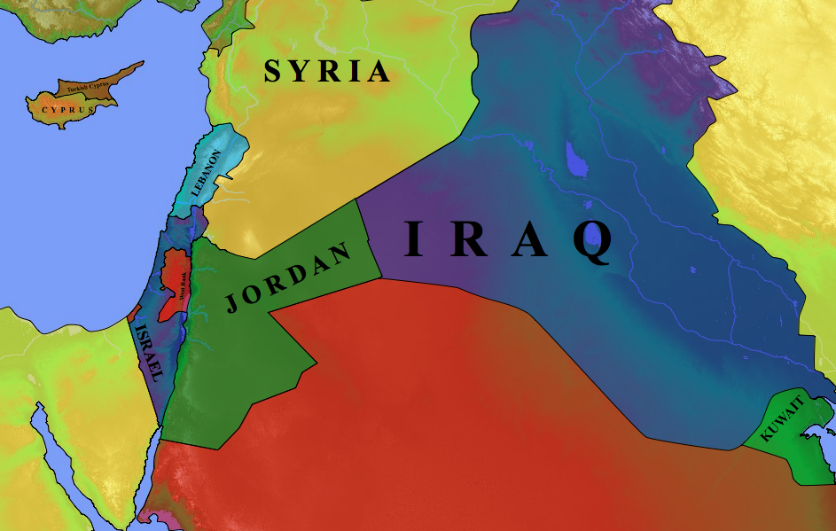
Modern Middle East Nations
27
Terry Hall, Bible Panorama, 49
Turkey
Russia
Syria
Cyprus
Iran
Lebanon
Iraq
Mediterranean Sea
Jordan
Israel
Saudi Arabia
Kuwait
Egypt

Slide 4

The Ancient Near East
28
Fertile Crescent
Iraq
Israel
Egypt

Slide 5
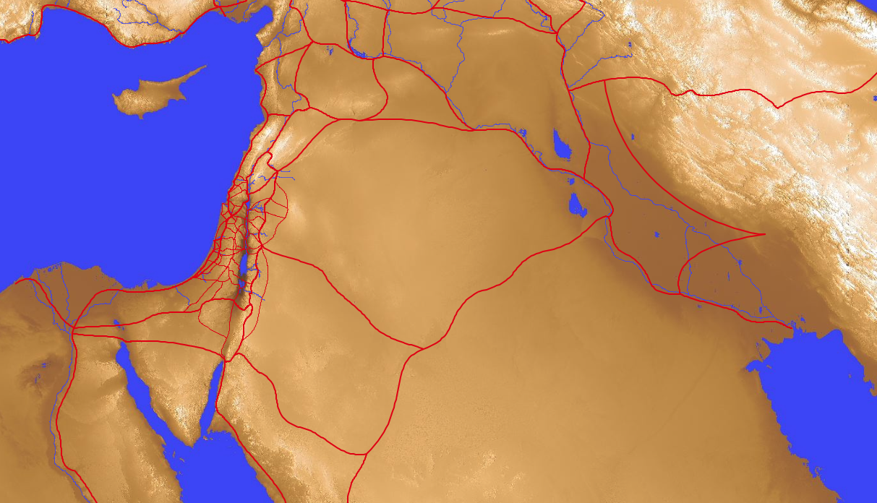
Old Testament Trade Routes & Bodies of Water
28
8
Tigris
7
1
Euphrates
Mediterranean
Sea
4
Sea of Chinnereth
5
Jordan River
6
Salt Sea
2
Nile River
9
Persian
Gulf
3
Red Sea
In your small group…
Name each of the 9 bodies of water
Tell how each got its name
Notes:
Mediterranean: "In the middle" (medi) + "lands" (terrain) = "between two lands" (Europe and Africa)
Nile River: "The name Nile comes from the Greek “neilos”, which means valley. The Ancient Egyptians called the river Ar or Aur (black) because of the colour of the sediment left after the river's annual flood (http://www.primaryhomeworkhelp.co.uk/egypt/nile.htm)
Red Sea: "Like the Yellow Sea, the Red Sea may also be named after a natural process. Seasonal blooms of a bacteria commonly called “sea sawdust” turn the water red. These bacteria, Trichodesmium erythraeum, help process nutrients in the ocean that certain small marine creatures depend upon. But there are other thoughts regarding how the Red Sea, which is an inlet of the Indian Ocean, got its name. Among them is the idea that it borders the “red land,” the name ancient Egyptians used to refer to the Egyptian Desert. Another theory states that the color red signifies “south.” Some Asiatic languages use colors to refer to directions" (http://www.dictionary.com/e/yellow-sea/)
Sea of Chinnereth: harp sea as it is shaped like the ancient harp
Jordan River: "The river's name in Hebrew is יַרְדֵן (Yarden), and it is derived from יָרַד (yarad) meaning "descend" or "flow down" (https://www.behindthename.com/name/jordan).
Salt Sea: sea with highest salt content on earth as it is the lowest spot where water stops and evaporates to make it continnually saltier
Euphrates River: "A river named Perath (Hebrew for Euphrates) is one of the four rivers that flow from the Garden of Eden according to Genesis 2:14. This Hebrew word, derived from either the word "stream" or "to break forth," has been translated as Euphrates" (http://www.newworldencyclopedia.org/entry/Euphrates_River)
Tigris River: "From Latin Tigris, from Ancient Greek Τίγρις (Tígris), an alternative form of Τίγρης (Tígrēs), from Old Persian 𐎫𐎡𐎥𐎼𐎠 (Tigrā), from Elamite 𒋾𒅅𒊏 (ti-ig-ra), from Sumerian 𒀀𒇉𒈦𒄘𒃼 (^{ÍD}Idigna, ^{ÍD}Idigina, literally “fast as an arrow”).} (https://en.wiktionary.org/wiki/Tigris#Etymology)
Persian Gulf: named after the land just to the north

Slide 6

Mesopotamia
28
T
Tigris
Mesopotamia
N
Nineveh
E
Euphrates
B
Babylon

Slide 7
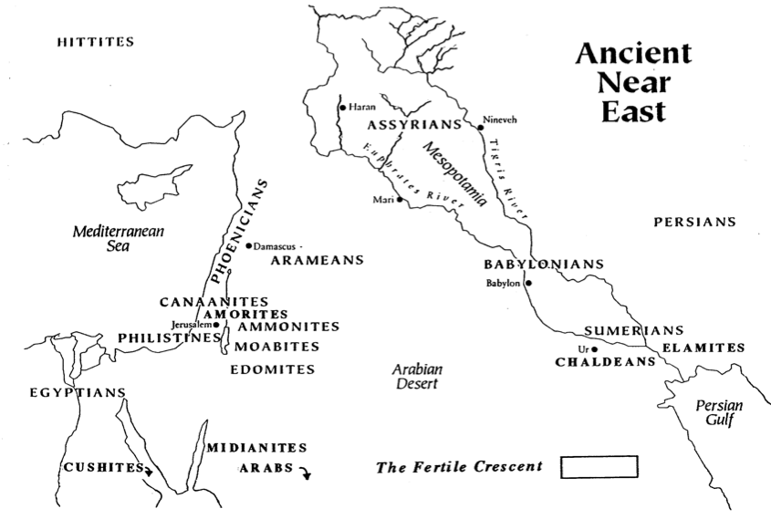
The Ancient Near East
Small Group:
Name the 7 cities
27
HITTITES
3
ASSYRIANS
Tigris
Haran
5
Euphrates
Nineveh
PHOENICIANS
Mesopotamia
2
Damascus
4
Mediterranean
Sea
Mari
PERSIANS
ARAMEANS
CANAANITES
BABYLONIANS
AMORITES
Babylon
6
Jerusalem
1
SUMERIANS
PHILISTINES
AMMONITES
MOABITES
7
ELAMITES
Ur
EDOMITES
CHALDEANS
Arabian
Desert
EGYPTIANS
MIDIANITES
Persian
Gulf
Fertile Crescent in Green
CUSHITES
ARABS
Alfred Hoerth et. al., Peoples of the Old Testament World, 16

Slide 8
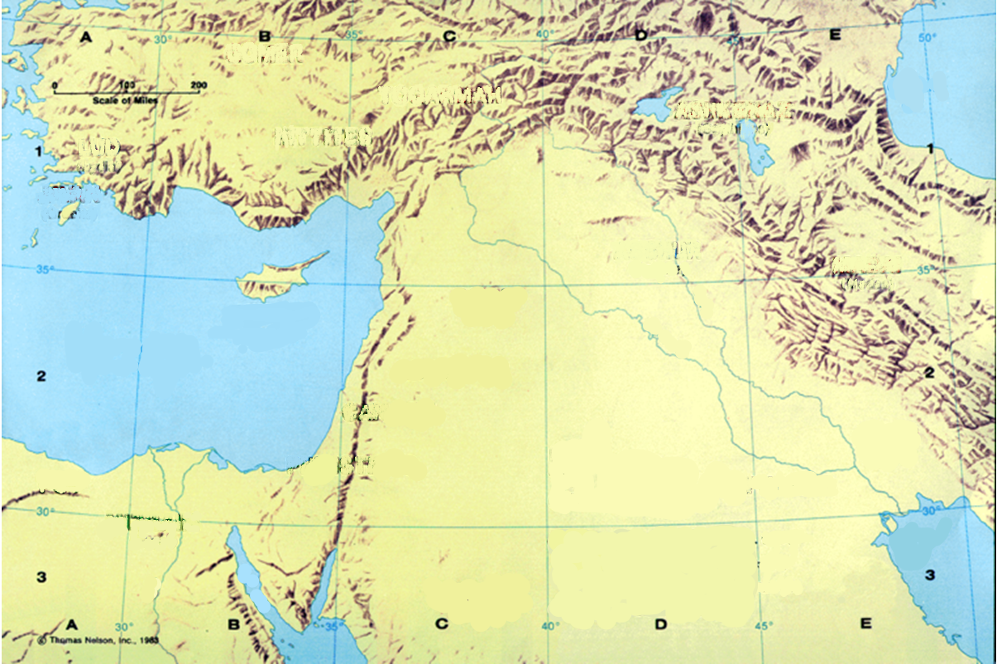
Old Testament
28

Slide 9
Old Testament Trade Routes
28

Slide 10
Water in the Mid-East
28
T
Tigris
Mesopotamia
N
Nineveh
E
Euphrates
B
Babylon

Slide 11
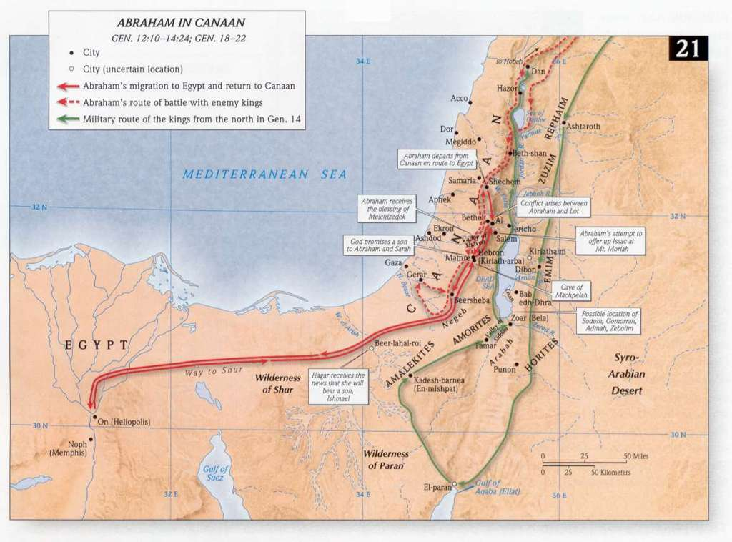

Slide 12
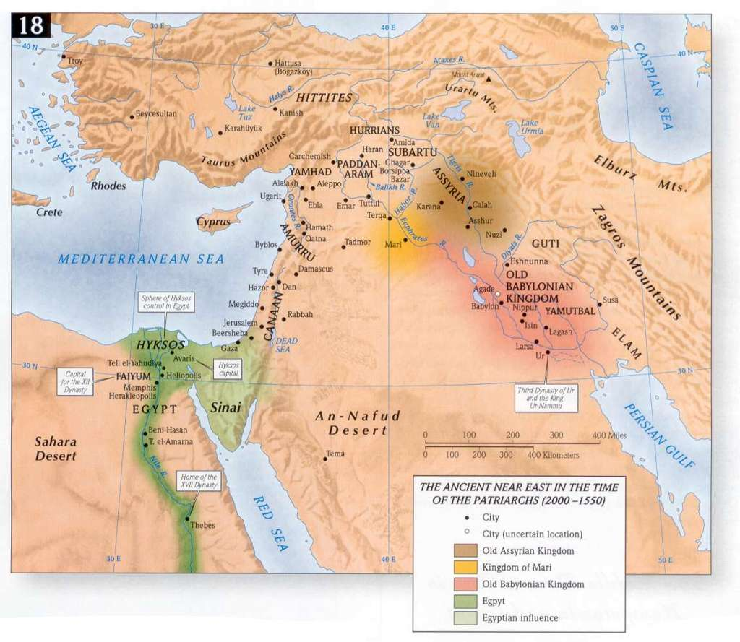

Slide 13
The Way to South Asia
28
Assyria
Syria
India

Slide 14
Confirmed ANE Chronologies
Mesopotamia:
• Old Babylon (1432-1180)
• Assyria (912-609)
• Neo-Babylon (626-539)
Israel
(dates fit beautiful
in between)
Egypt
(1550/1540-525)
Notes:
“﻿The framework of ancient Near Eastern history in this epoch is provided by the two major hearths of complex civilization of that day, namely, Mesopotamia (Assyria and Babylonia) on the east and Egypt to the southwest. Before Alexander the Great (336-323) we have the Persian Empire, which ended the independence of Babylon in 539 (by Cyrus) and (for a time) of Egypt in 525 (by Cambyses). All these dates are firm and universally accepted. In Mesopotamia the Neo-Babylonian kings ruled Babylonia from 626 to 539. Overlapping at the end and preceding them, the kings of Assyria are dated to the year from 912 down to 648 (eponym lists, 911/910ff., plus king lists), and to the final end of Assyria in 609. Before 912 Assyrian dates are closely correct back to 1180, before which a dispute over three or thirteen years for Ninurta-apil-ekur gives a maximum ten-year variation back to 1432/1422 for the accession of Enlil-nasir II. Thus from 1180 (and quite closely from the late fifteenth century) Assyrian dates provide a firm backbone of dating other, less securely fixed regions in the Near East.61
On the other side of the area, Egypt also makes a valuable contribution, essentially independent of Mesopotamia. Thus, before the Persian conquest in 525, the Twenty-Sixth (Saite) Dynasty reigned to the year during 664 to 525. The reign of Tanutamun was contemporary with the Twenty-Sixth Dynasty, and the Twenty-Third and Twenty-Fourth Dynasties were wholly contemporary with the Twenty-Second and with each other; so none of these affect the flow of successive dates. Before the Twenty-Sixth Dynasty, Taharqa of the Twenty-Fifth (Kushite/Nubian) Dynasty reigned from 690 to 664. Before this date, it is now clear that Shebitku reigned from at least 702 (and perhaps 706), and his predecessor Shabaka for fourteen years, thirteen over Egypt, maximally 719/minimally 715 to 702. Before him in Egypt, but not ending before 716 (Osorkon IV = Shilkanni of an Assyrian text in 716), the Twenty-Second (Libyan) Dynasty reigned an absolute minimum of close to 230 years, beginning with Shoshenq I (“Shishak”) from 945 (or extremely close to it). Note that this Egyptian chronology stands independently of both the Assyrian and Hebrew data.
Before 945, the Twenty-First Dynasty goes back to 1070 within a year or so. Earlier still, the Ramesside Nineteenth and Twentieth Dynasties (New Kingdom) go back to firm dates of 1279-1213 (not 1212!) for Ramesses II, and for the preceding Eighteenth Dynasty and start of the New Kingdom to either 1550 or 1540 (again, varying because of a king [Tuthmosis II] who reigned either three or thirteen years).62”
Kenneth A. Kitchen, On the Reliability of the Old Testament (Grand Rapids, MI: Eerdmans, 2003), 22-23 (Kindle Edition Loc 780-796 of 14432)

Slide 15
Inventing “History”
Babylon
(Berossus)
Israel
(OT?)
Egypt
(Manetho)
Notes:
“﻿After all, others were doing this then. In the third century B.C. the Egyptian priest Manetho produced his Aegyptiaka, or history of Egypt, probably under Ptolemy II,1 and by then so also did Berossus, priest of Marduk at Babylon, his Chaldaika, for his master, the Seleucid king Antiochus I.2 Comparison with firsthand sources shows that these two writers could draw upon authentic local records and traditions in each case. So it is in principle possible to suggest that a group of early Hellenistic Jews tried to perform a similar service for their community by composing the books we now know as the Old Testament or Hebrew Bible.”
Kitchen, K. A.. On the Reliability of the Old Testament . Grand Rapids: Eerdmans, 2003. Kindle Edition.

Slide 16
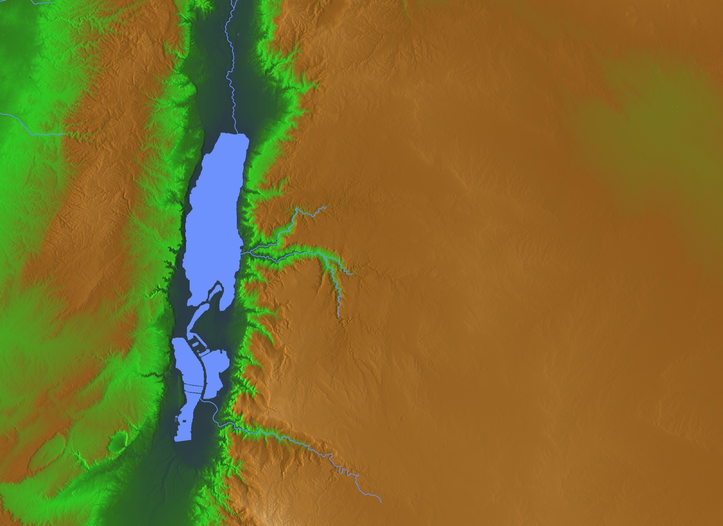
The Choice
Abram & Lot
"Lot took a long look at the fertile plains of the Jordan Valley in the direction of Zoar. The whole area was well watered everywhere, like the garden of the LORD or the beautiful land of Egypt. (This was before the LORD destroyed Sodom and Gomorrah.)"
(Gen 13:10 NLT).
• Gomorrah?
• Sodom?
• Zoar
Notes:
Abram gave Lot the choice where to live. As godless people today take the most beautiful places, so it was then.
• From his northly position, Lot looked south all the way to Zoar and saw lush land.
• He chose to live in Sodom—the city from which he could manage his rural flocks.
• Gomorrah lay close by as well—another godless city of sexual perversion.
• For Lot, the choice was easy—so he moved into the fertile plain—though his should was vexed on how he could impact them:
2Pet. 2:7 But God also rescued Lot out of Sodom because he was a righteous man who was sick of the shameful immorality of the wicked people around him. ⁸ Yes, Lot was a righteous man who was tormented in his soul by the wickedness he saw and heard day after day.
• Abram, on the other hand, chose the rocky hill country.

Slide 17
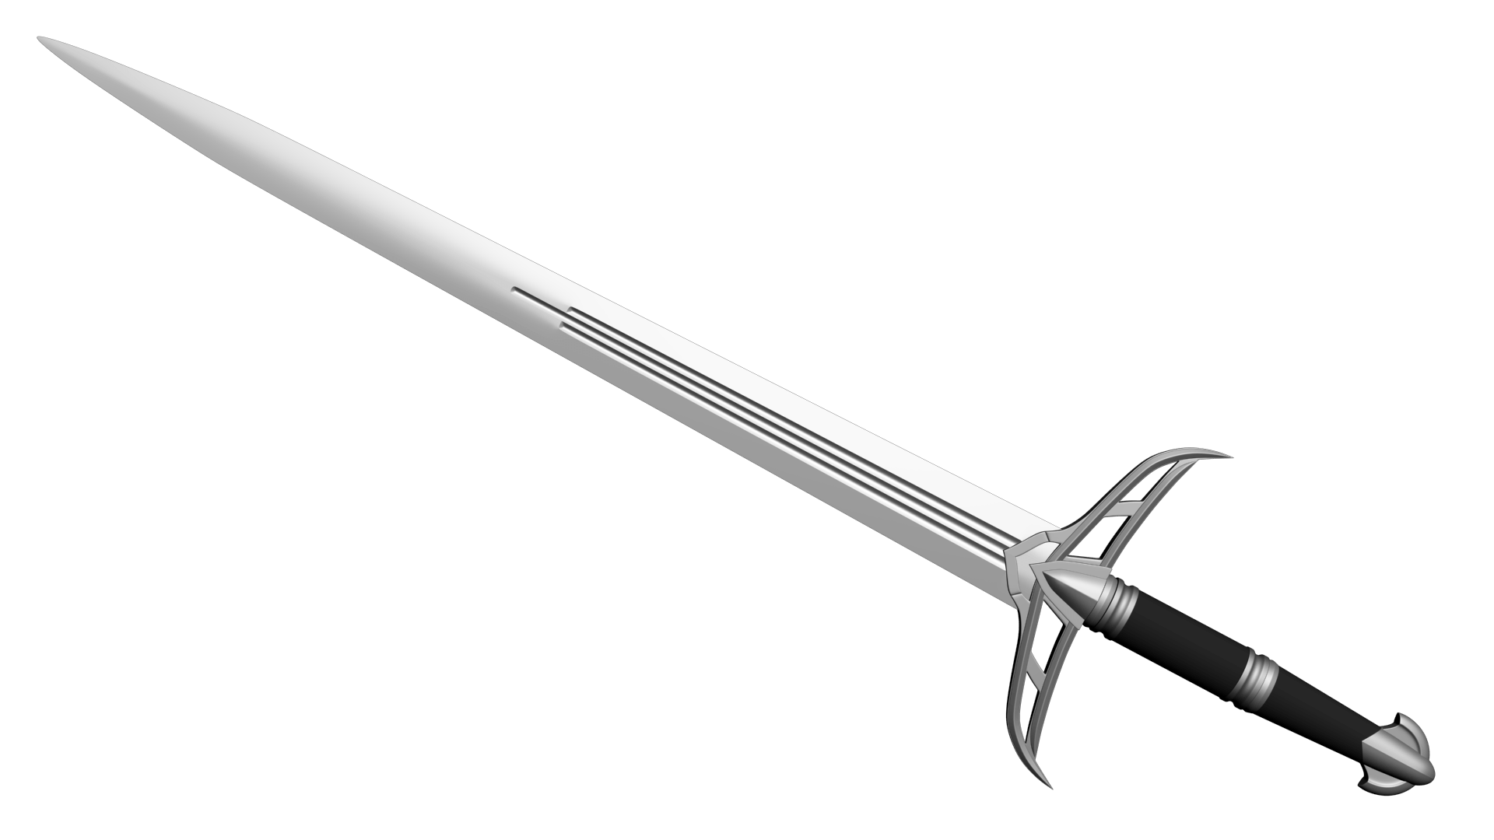
God's Sword—Ezekiel 21
??
• Ammon
Jerusalem •
"One road [goes] to Ammon and its capital, Rabbah, and the other to Judah and fortified Jerusalem.
²¹The king of Babylon now stands at the fork, uncertain whether to attack Jerusalem or Rabbah. He calls his magicians to look for omens. They cast lots by shaking arrows from the quiver. They inspect the livers of animal sacrifices"
(Ezekiel 21:20-21 NLT).
Notes:
The coming judgment under Nebuchadnezzar would be God's sword against the nation and Ammon (Ezek 21).
Ezekiel 21:1-5 reads, "Then this message came to me from the LORD: ² “Son of man, turn and face Jerusalem and prophesy against Israel and her sanctuaries. ³ Tell her, ‘This is what the LORD says: I am your enemy, O Israel, and I am about to unsheath my sword to destroy your people—the righteous and the wicked alike. ⁴ Yes, I will cut off both the righteous and the wicked! I will draw my sword against everyone in the land from south to north. ⁵ Everyone in the world will know that I am the LORD. My sword is in my hand, and it will not return to its sheath until its work is finished.’"
God then tells Ezekiel to continually groan aloud before the people until they ask why, and then he is to tell them that God's sword will strike all those in Jerusalem (21:6-17).
• The chapter ends with Babylon as God's sword. He travels south until the road splits and he isn't sure which way to go.
• (Read 20-21 above)
• The omens say first to attack Jerusalem
• But 21:28-32 is a message against Ammon also, which the Babylonians also later conquered.

Slide 18
Borders of the Land Promised to Abraham
Syria
Lebanon
Israel
Jordan
Genesis 15:18
"On that day the LORD made a covenant with Abram, saying, 'To your offspring I give this land, from the river of Egypt to the great river, the river Euphrates'" (ESV)
India
Egypt
Notes:
God’s promised land stretched northeard from the small wadi of Egypt south in the Sinai to the large Euphrates River in the far north—a HUGE piece of real estate! When today’s boundaries are placed over this land we can see the struggle modern Israel has to claim land from Egypt, Lebanon, Syria and possibly even Jordan on the other side of the Jordan River.

Slide 19
Promised Land Borders to Moses (Num 34)
Syria
Lebanon
Jordan
Israel
Egypt
Notes:
God’s promised land stretched northeard from the small wadi of Egypt south in the Sinai to the large Euphrates River in the far north—a HUGE piece of real estate! When today’s boundaries are placed over this land we can see the struggle modern Israel has to claim land from Egypt, Lebanon, Syria and possibly even Jordan on the other side of the Jordan River.

Slide 20
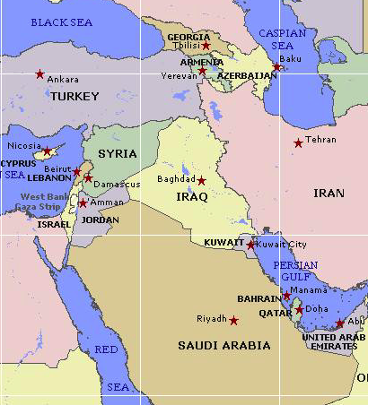

Borders of the Land Promised to Abraham
44
Genesis 15:18
"On that day the LORD made a covenant with Abram, saying, 'To your offspring I give this land, from the river of Egypt to the great river, the river Euphrates'" (ESV)

Slide 21

Map Preceding Numbers
• Zoan
• Rameses
Kadesh- Barnea
GOSHEN
• Marah
• Elim
Desert of Sin
Midian
• Rephidim
Mt. Sinai
Route of the Exodus

Slide 22
Geographical Start of Numbers
• Marah
• Elim
Midian
Desert of Sin
• Rephidim
Mt. Sinai

Slide 23
Geographical End of Numbers
Moab
Goshen
Mt. Hor
Kadesh- barnea
Mt. Sinai

Slide 24
Wilderness Wanderings
Injustice
Moab
Egypt
Kadesh- barnea
Injustice
Mt. Sinai

Slide 25
Numbers 1–12 Map
• Zoan
• Rameses
Kadesh- barnea
GOSHEN
• Marah
• Elim
Desert of Sin
• Rephidim
Mt. Sinai
Route of the Journey

Slide 26
Geographical End of Numbers
Moab
Kadesh- barnea
Mt. Hor
Mt. Sinai

Slide 27



The Nineveh Metropolis
OTS 602
Rehoboth Ir
Size of Singapore
Nineveh Proper
The Great City of Nineveh
Resen
Calah
Genesis 10:11-12
0
kilometers
20
Notes:
There's a problem here regarding the three-day's journey (cf. OTS, 602). Nineveh's inner wall was less than eight miles, so the diameter of the city was only two miles—hardly a three-day journey. One day's journey in the open was usually 15-20 miles (Hannah, BKC, 1:1463).
But this isn't really a problem in either of two ways:
“The great city of Nineveh” (1:2; 3:2; cf. 4:11) almost surely included three other towns in the vicinity as well. Four cities (Nineveh, Rehoboth Ir, Calah, and Resen) are mentioned in Genesis 10:11-12 as “the great city” and they still exist today with different names (Kouyunjik, Khorsbad, Nimroud, and Karamles). This can be observed on the following map by Austin Henry Layard, Nineveh and Its Remains, 2:40.
If we superimpose a map of Singapore over it, we can see that walking through Nineveh would be like walking in Singapore from the far north in Yishun to Harbourfront in the south. That could take 3 days easily!
27

Slide 28
The Babylonian Threat
Babylonian Expansion
Mediterranean
Sea
Syria
Babylon
Israel
Judah
586 BC
Persian
Gulf
Egypt

Slide 29
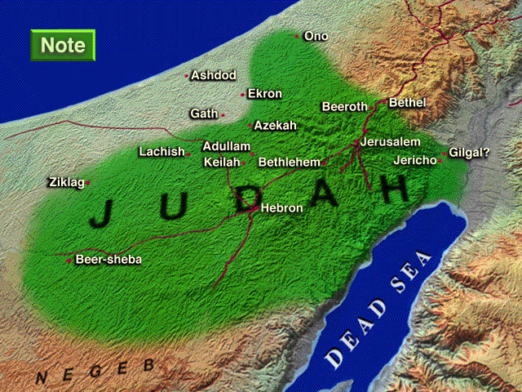

Enemies in Nehemiah's Time
Sanballat
the Samaritan
Tobiah
the Ammonite
NEHEMIAH
Geshom
the Arab
Notes:
29
^{18�} Then I told them about how the gracious hand of God had been on me, and about my conversation with the king.
They replied at once, “Yes, let's rebuild the wall!” So they began the good work.
^{19�} But when Sanballat, Tobiah, and Geshem the Arab heard of our plan, they scoffed contemptuously. “What are you doing? Are you rebelling against the king?” they asked.
^{20�} I replied, “The God of heaven will help us succeed. We, his servants, will start rebuilding this wall. But you have no share, legal right, or historic claim in Jerusalem.”
Tyndale House Publishers., Holy Bible : New Living Translation., 2nd ed. (Wheaton, Ill.: Tyndale House Publishers, 2004), Ne 2:18.
Map Has Settlements of the Persian Province of Judah According to Ezra and Nehemiah (Logos Libronix Bible Maps, Mac edition, 2008)

Slide 30
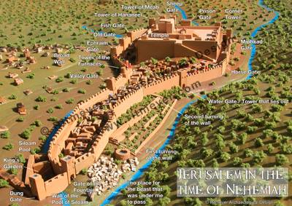
Internal Problems Right at Home
Chapter 5

Slide 31
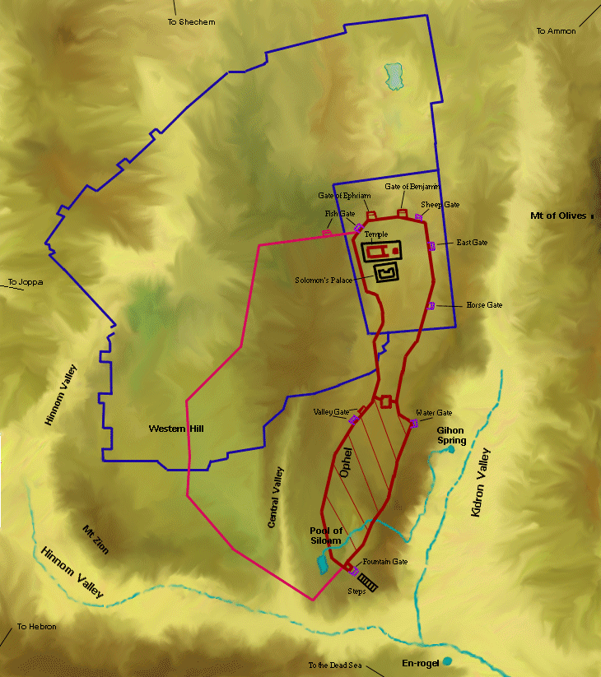
Tower of Hananel
Tower of 100
Mount of Olives
Sheep Gate
Fish Gate
Inspection Gate
Jeshanah (Old Gate?)
East Gate
Broad Wall
Horse Gate
Tower of the Ovens?
Wall of Ophel
Great Projecting Tower
Valley Gate
Water Gate
Dung Gate
The Angle
Pool of Shelah (Siloam)
Fountain Gate
Notes:
31

Slide 32
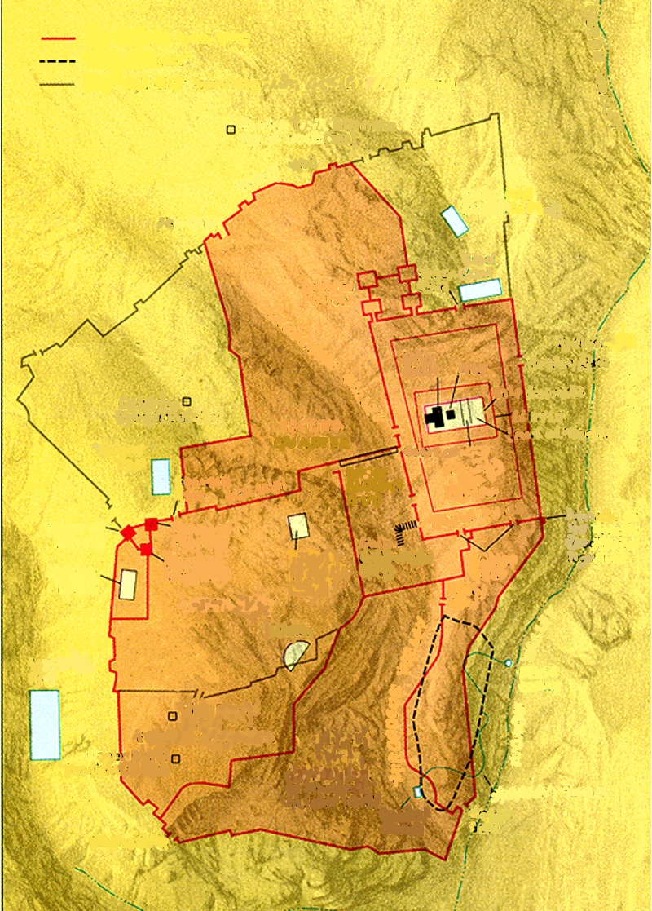
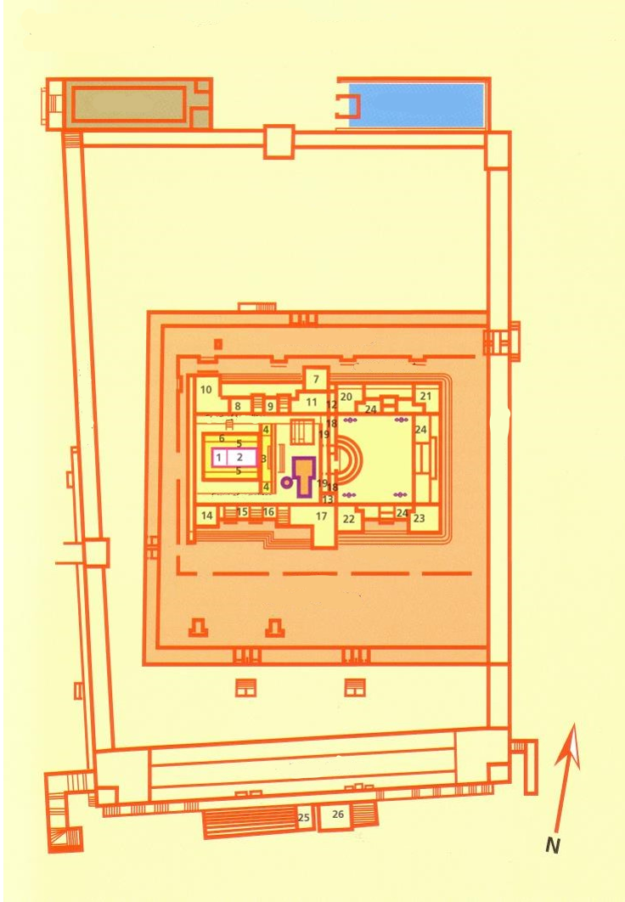
Jerusalem

Slide 33
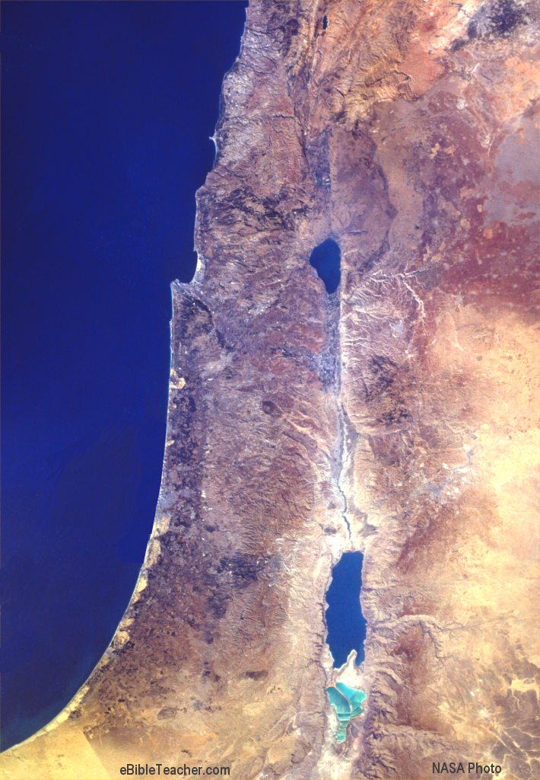
Israel Today

Slide 34

Israel
(AD 67-68)
Jerusalem

Slide 35
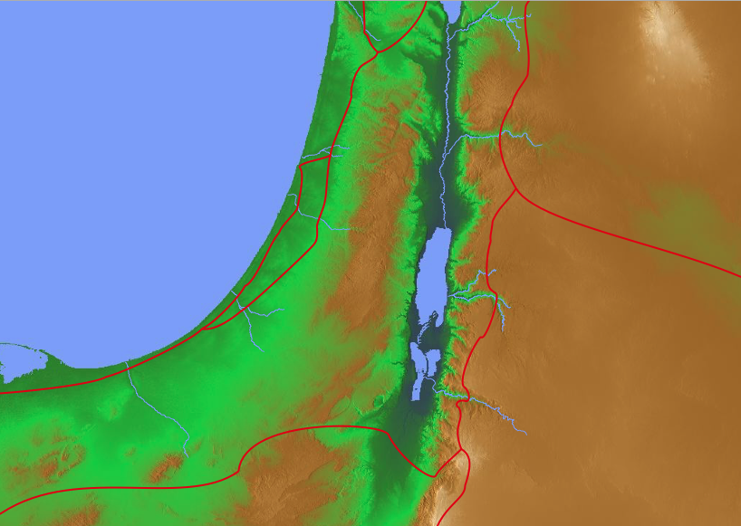
Israel with Highways

Slide 36
Promised Land Borders (Numbers 34)
Notes:
God’s promised land stretched northeard from the small wadi of Egypt south in the Sinai to the large Euphrates River in the far north—a HUGE piece of real estate! When today’s boundaries are placed over this land we can see the struggle modern Israel has to claim land from Egypt, Lebanon, Syria and possibly even Jordan on the other side of the Jordan River.

Slide 37
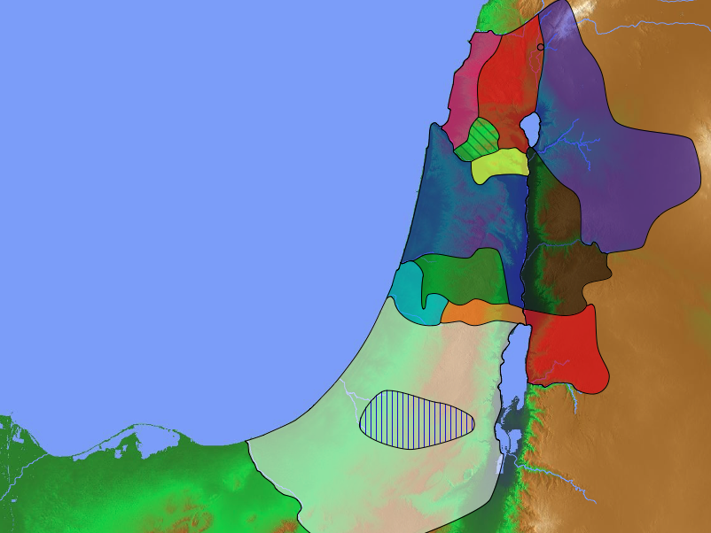
Populations by Tribe
Dan
64,400
171
Asher
53,400
Naphtali
45,400
Numbers 26
Joshua 13:1–19:48
Zebulun
60,500
Manasseh
Issachar
64,300
Manasseh
52,700
Levi
23,000
Spread Throughout Israel
Gad
40,500
Ephraim
32,500
Dan
64,400
Benjamin
45,600
Reuben
43,730
Judah
76,500
Simeon
22,200

Slide 38
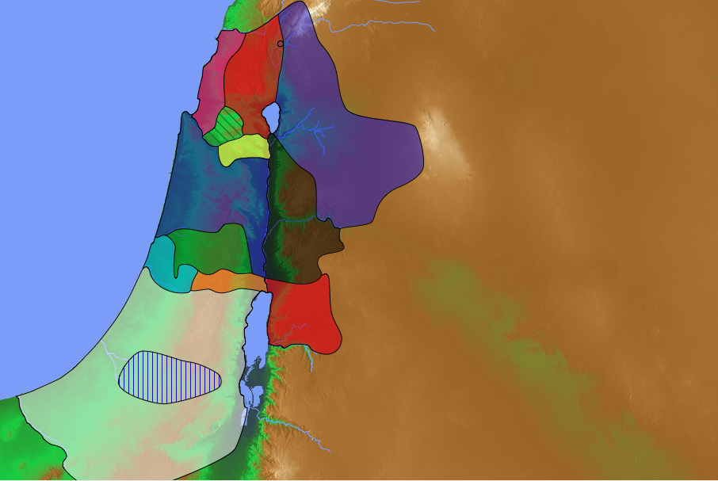
Final Preparations (Numbers 31–36)
Tribal Boundaries of Israel
Naphtali
Asher
Transjordan Settled (31–32)
  Midianites (31)
Zebulun
Manasseh
Issachar
Manasseh
Gad
Ephraim
Dan
Benjamin
Reuben
Judah
Simeon

Slide 39
Final Preparations (Numbers 31–36)
Eastern Tribes
Transjordan Settled (31–32)
  Midianites (31)
  Inheritances (32)
Wandering Summary (33:1-49)
Canaan Defined (33:50–36:13)
  Inheritance (33:50–34:29)
  Levitical Cities (35)
Manasseh
Gad
Reuben

Slide 40
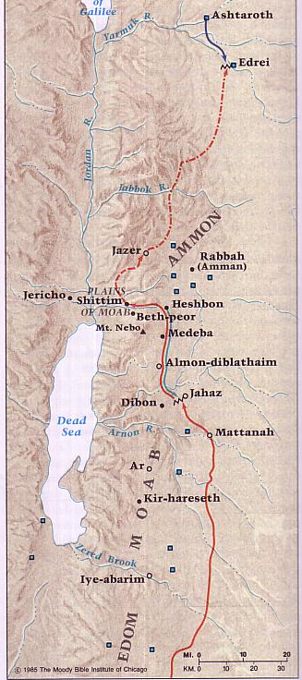
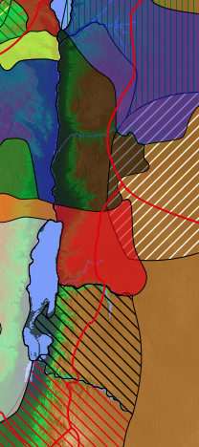
Transjordan Events
140
Edrei
Kingdom of Sihon
Ammon
Victory over Sihon and Og (Num. 21)
Balak fails to turn God against Israel–blessing by Balaam (Num. 22–24)
Kingdom of Og
Jahaz
Moab
Edom
Beitzel, Moody Atlas, 1st ed., 94
Neighboring nations related by blood

Slide 41
Transjordan Events
140
Victory over Sihon and Og (Num. 21)
Balak fails to turn God against Israel–blessing by Balaam (Num. 22–24)
Balak succeeds to turn Israel against God–immorality at Beth-peor (Num. 25)
Beth-peor
Beitzel, Moody Atlas, 1st ed., 94

Slide 42
Taking Care of Priorities
(Josh 3:2; 5:2-3)
"At that time the Lord told Joshua, 'Make flint knives and circumcise this second generation of Israelites.' ³So Joshua made flint knives and circumcised the entire male population of Israel at Gibeath-haaraloth" (Joshua 5:2-3 NLT).
171
Zebulun
Issachar
Manasseh
Gilgal
Acacia Grove
Jericho
Notes:
Rather than Israel going straight across the Jordan River to Jericho, God had them stop at Gilgal to the north. But why? Their parents had not believed God could bring them into the land 39 years earlier in the desert city of Kadesh-Barnea, and therefore been judged to die in the wilderness (Numbers 13–14). But this older generation also had not followed the covenant sign of circumcision given to Abraham (Genesis 17) by circumcising their baby boys born in the desert. How could they go attack the land as uncircumcised people of God? So God had them do something amazing—to be circumcised right there with Jericho in sight. They named the place Gibeath-haaraloth, or "Hill of Foreskins," for over 600,000 foreskins were stacked on the ground. This took days to heal and left them defenseless against the giants of the land. However, it underscored the priority of spiritual preparation over military readiness.

Slide 43
Tribes of Blessing & Cursing at Shechem
Naphtali
Dan
Asher
171
Deuteronomy 27:12-13
Joshua 8:33
Zebulun
Issachar
Manasseh
Manasseh
Shechem
Gad
Levi
Ephraim
Benjamin
Reuben
Judah
Simeon
Blessing Tribes on Gerizim
Cursing Tribes on Ebal
Notes:
“Then Moses and the Levitical priests addressed all Israel as follows: ‘O Israel, be quiet and listen! Today you have become the people of the LORD your God. ¹⁰ So you must obey the LORD your God by keeping all these commands and decrees that I am giving you today.’ ¹¹ That same day Moses also gave this charge to the people: ¹² ‘When you cross the Jordan River, the tribes of Simeon, Levi, Judah, Issachar, Joseph, and Benjamin must stand on Mount Gerizim to proclaim a blessing over the people. ¹³ And the tribes of Reuben, Gad, Asher, Zebulun, Dan, and Naphtali must stand on Mount Ebal to proclaim a curse’” (Deut. 27:11-13).
Josh. 8:33 Then all the Israelites—foreigners and native-born alike—along with the elders, officers, and judges, were divided into two groups. One group stood in front of Mount Gerizim, the other in front of Mount Ebal. Each group faced the other, and between them stood the Levitical priests carrying the Ark of the Lord’s Covenant. This was all done according to the commands that Moses, the servant of the Lord, had previously given for blessing the people of Israel.

Slide 44
Transjordan Tribes
140
Joshua 13
Manasseh
Gad
Reuben
Eastern tribes

Slide 45
Transjordan Tribes
140
Joshua 13
Manasseh
Gad
Reuben
Eastern tribes

Slide 46
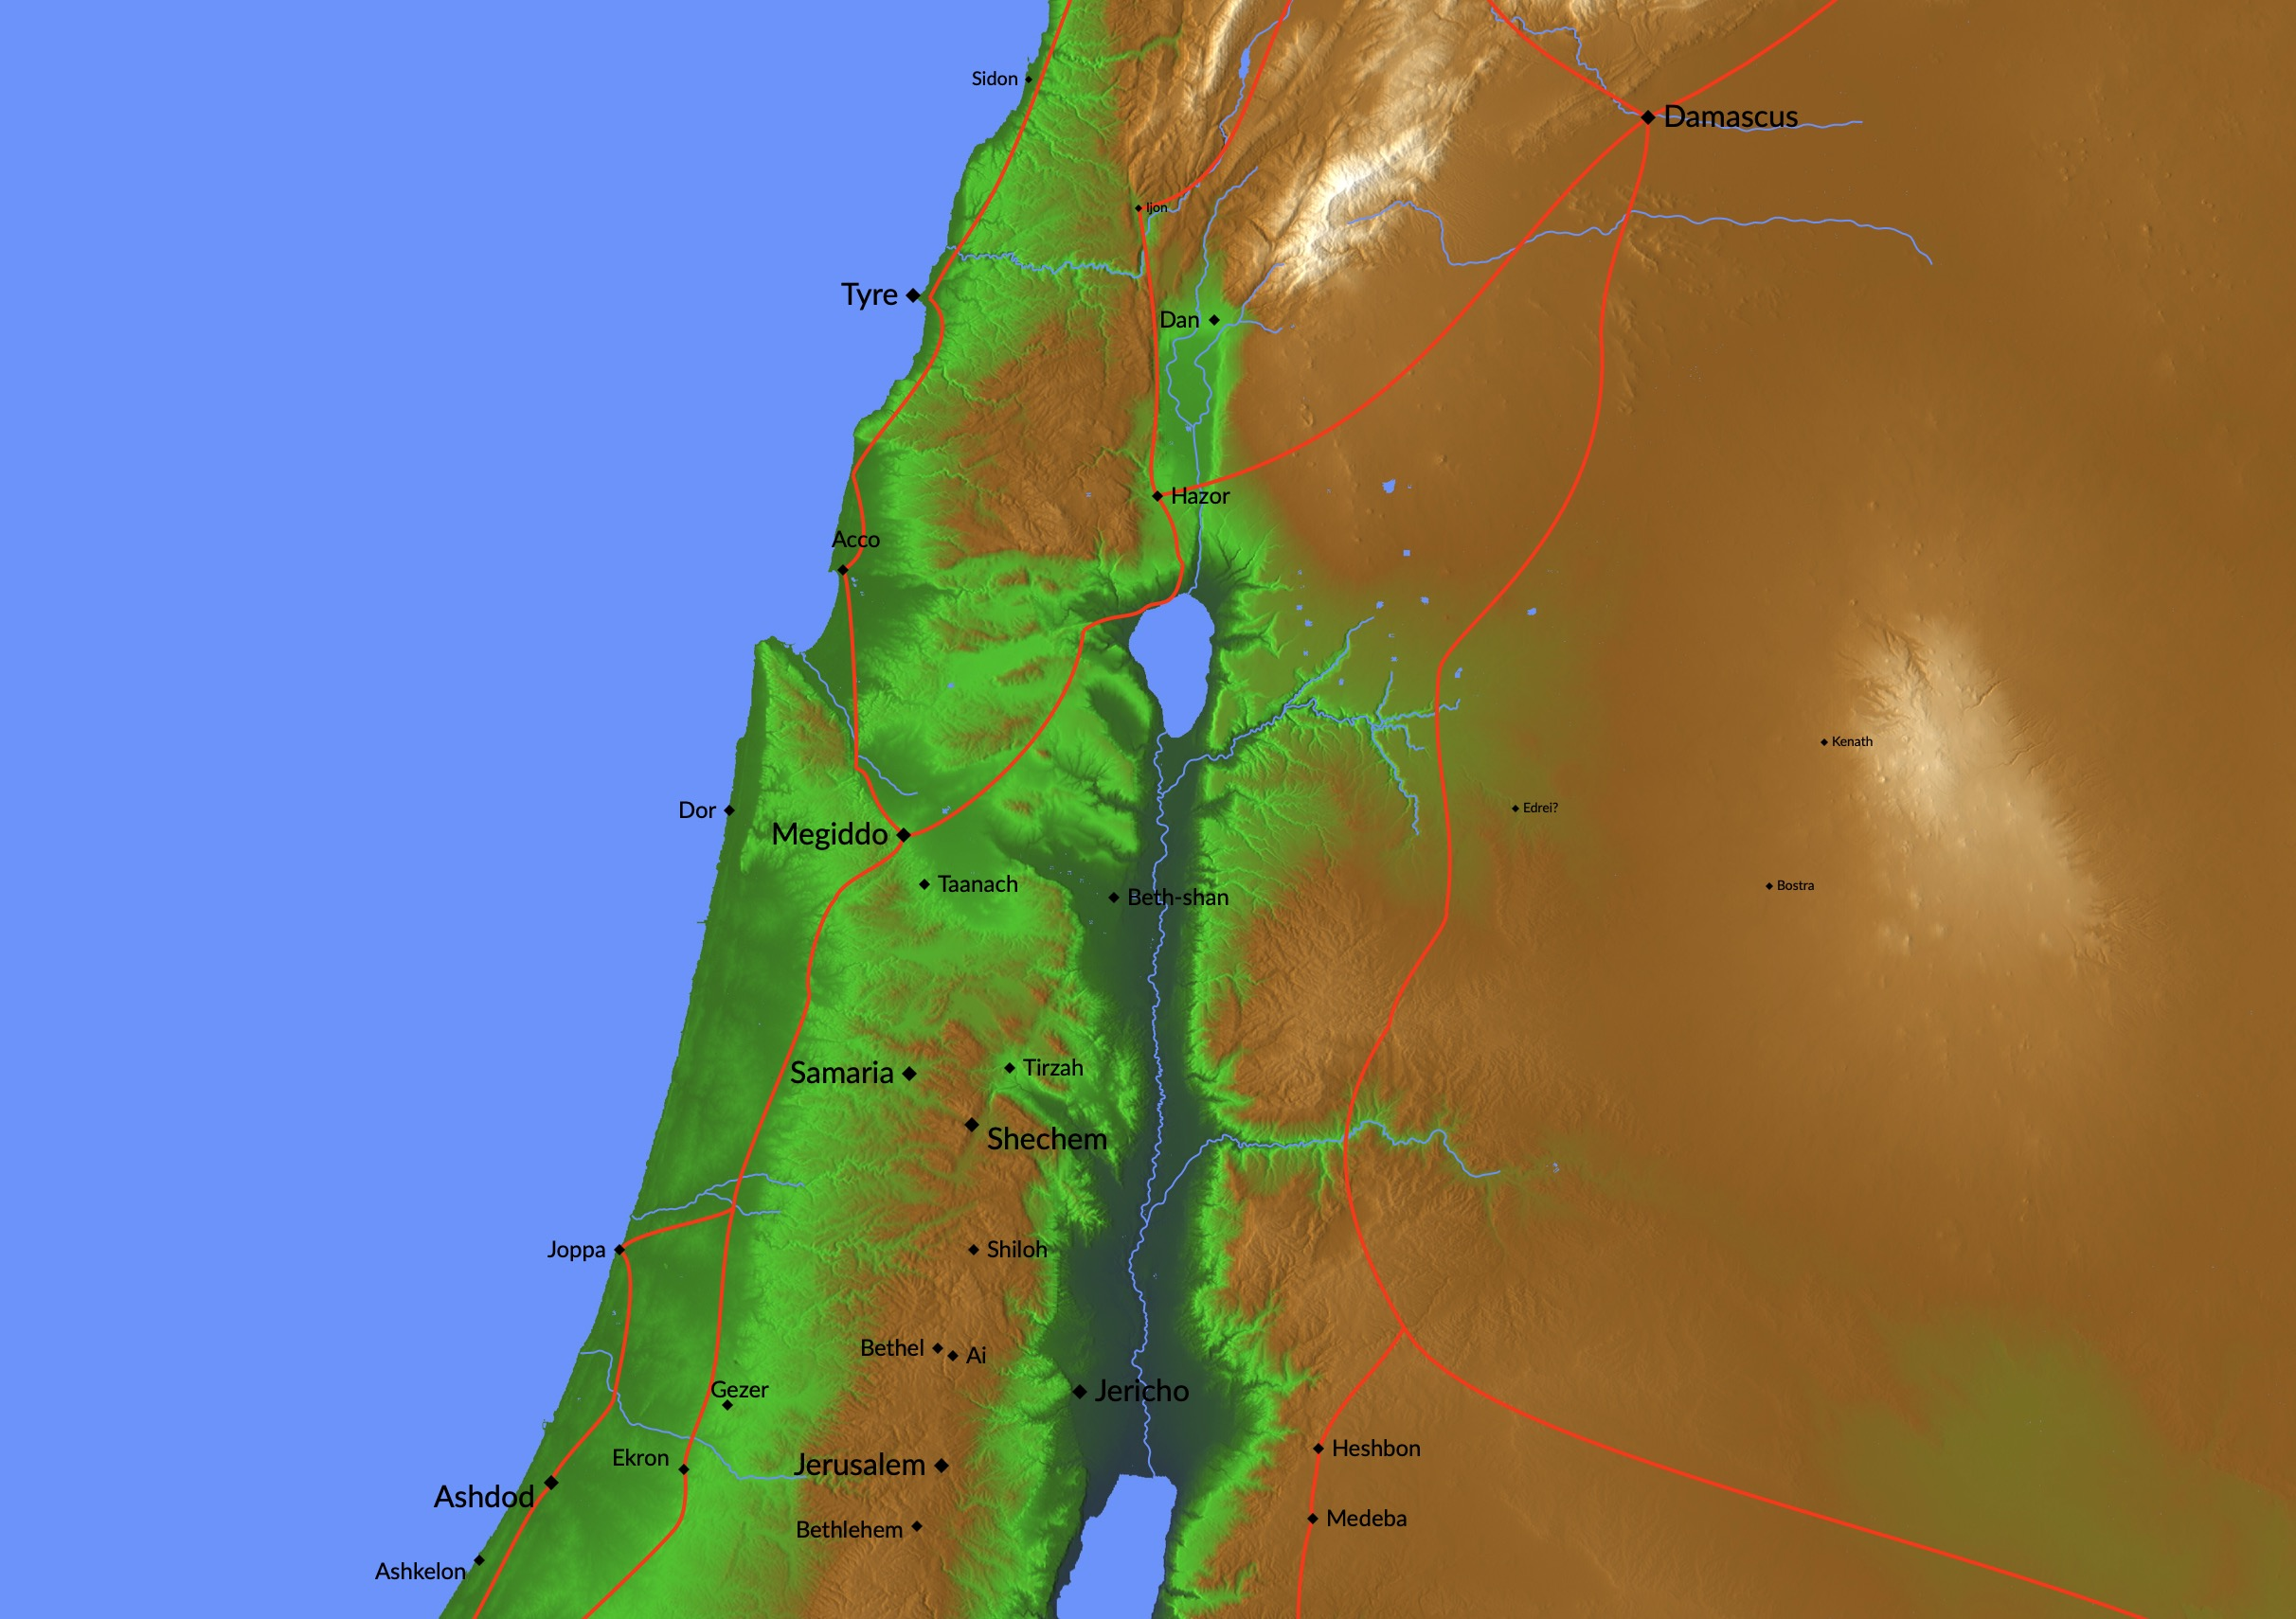
Evidence for an Early Date for the Book of Joshua
Sidon (13:6)
Tyre (2 Sam 5:11)
Gezer (16:10)
Jerusalem (15:63)
Notes:
"Several reasons suggest that the book of Joshua was composed soon after the occurrence of the events themselves. Three primary passages support an early date for the composition of the contents of the book.
• First, 13:6 mentions Sidon as the dominant city of Phoenicia. Sidon’s superiority over Tyre was true only before the rise of the Israelite monarchy which witnessed the beginning of Tyre’s prominent role on the Phoenician coastline. [Not conquered was "…all the hill country from Lebanon to Misrephoth-maim, including all the land of the Sidonians"—Josh 13:6]
• Similarly, 15:63 mentions that the Jebusites were the inhabitants of Jerusalem. The non-Israelite occupation of Jerusalem by the Jebusites was true only in the time before David’s rise to power when he conquered Jerusalem and turned it into the national capital. [Josh. 15:63 "But the tribe of Judah could not drive out the Jebusites, who lived in the city of Jerusalem, so the Jebusites live there among the people of Judah to this day."]
• Third, 16:10 mentions that the Israelites failed to drive the Canaanites out of Gezer and that the Canaanites remained in the city at the time of the book’s composition: “to this day.”⁸ ["They did not drive the Canaanites out of Gezer, however, so the people of Gezer live as slaves among the people of Ephraim to this day."] This chronological note indicates that the writing of the account and of the book must have taken place before Solomon’s lifetime because in Solomon’s reign the Canaanites of Gezer were massacred by the Egyptians (1 Kgs 9:16).⁹
⁸ This expression occurs in 4:9; 5:9; 6:25; 7:26(twice); 8:28–29; 9:27; 10:27; 13:13; 14:14; 15:63; 16:10; and 9:27 has “as they are today.” B. Childs concedes that the use of the phrase in 15:63 and 16:10 indicates a recording of the events in a period not later than the tenth century BC (“A Study of the Formula, ‘Until This Day,’ ” JBL 82 [1963]: 279–92).
⁹ Moreover, the author of Joshua said nothing about the decline and apostasy of the judges."
Mark F. Rooker, “The Book of Joshua,” in The World and the Word: An Introduction to the Old Testament (Nashville, TN: B&H Academic, 2011), 278.

Slide 47
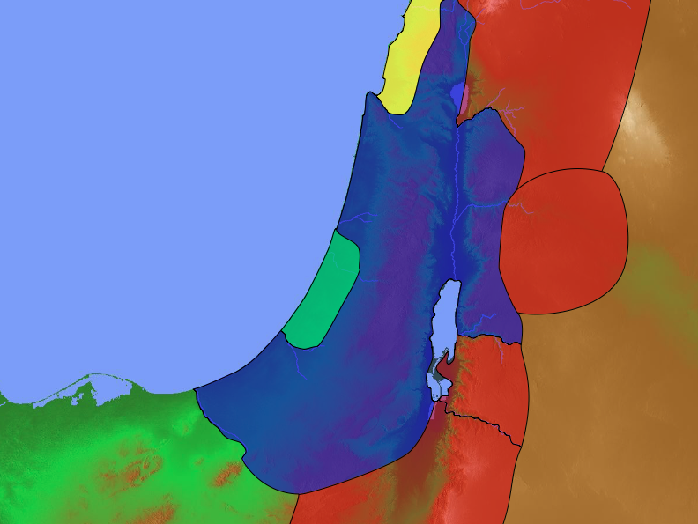
Conquest Promise
Lebanon
Euphrates
Joshua 1:3-5 NLT
"I promise you what I promised Moses: ‘Wherever you set foot, you will be on land I have given you— ⁴from the Negev wilderness in the south to the Lebanon mountains in the north, from the Euphrates River in the east to the Mediterranean Sea in the west, including all the land of the Hittites.’
⁵No one will be able to stand against you as long as you live. For I will be with you as I was with Moses. I will not fail you or abandon you."
Canaan
Egypt
Negev

Slide 48
Tribal Boundaries of Israel
171
Manasseh
Joshua 13–17
Manasseh
Gad
Ephraim
Reuben
Judah
Eastern tribes
Firstborn double portion & kingly tribe

Slide 49
Tribal Boundaries of Israel
Naphtali
171
Asher
Zebulun
Manasseh
Issachar
Joshua 13:1–19:48
Manasseh
Levi
Gad
Spread
Ephraim
Dan
Ammon
LZGA (Leah—Zilpah)
Benjamin
Reuben
RBDN (Rachel—Bilhah)
RBJ (Rachel)
Judah
LRSLJIZ (Leah)
Simeon
Moab
Eastern tribes
Firstborn double portion & kingly tribe
Seven tribal allotments by lot
Neighboring nations related by blood
Edom

Slide 50
Tribal Allotments
171
Asher
Naphtali
Joshua 13:1–19:48
Zebulun
Manasseh
Issachar
Manasseh
Gad
Ephraim
Dan
Benjamin
Reuben
Judah
Simeon

Slide 51
David: Hebron to Jerusalem
171
Asher
Naphtali
Zebulun
Manasseh
Issachar
2 Samuel 5
Manasseh
Gad
Ephraim
Dan
Benjamin
Jerusalem
Reuben
Judah
Hebron
Simeon

Slide 52
Populations by Tribe
171
Asher
53,400
Naphtali
45,400
Numbers 26
Joshua 13:1–19:48
Zebulun
60,500
Manasseh
Issachar
64,300
Manasseh
52,700
Levi
23,000
Spread Throughout Israel
Gad
40,500
Ephraim
32,500
Dan
64,400
Benjamin
45,600
Reuben
43,730
Judah
76,500
Simeon
22,200

Slide 53
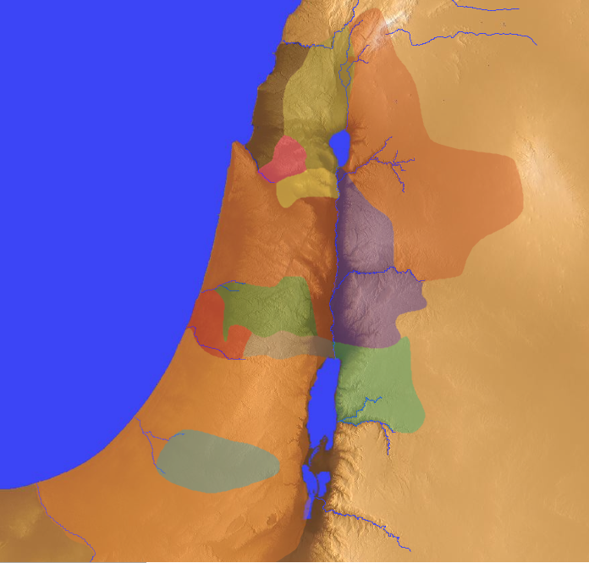
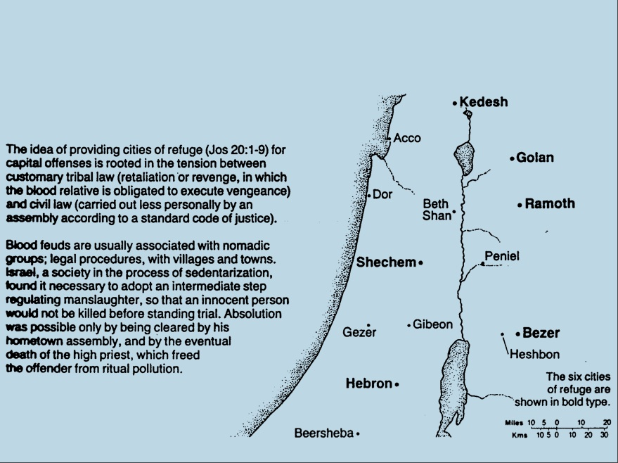
Cities of Refuge
Israel lived in a nomadic culture of personal vengeance by family members against the offending family (blood feuds).
Yet the nation was not ready for legal procedures by an objective village assembly (civil law).
Therefore, God instituted an intermediate step of six nearby cities where one who accidently killed someone could flee.
142
Kedesh
Golan
Ramoth
Shechem
Bezer
Hebron
Numbers 35; Josh. 20:1-9
Notes:
"The idea of providing cities of refuge (Josh. 20:1-9) for capital offenses is rooted in the tension between customary tribal law (retaliation or revenge, in which the blood relative is obligated to execute vengeance) and civil law (carried out less personally by an assembly according to a standard code of justice)" (The Bible Visual Resource Book, 35).

Slide 54
48 Levitical Cities
171a
6 Cities of Refuge

Slide 55
Tribal Boundaries of Israel
Naphtali
171
Asher
Zebulun
Manasseh
Issachar
Manasseh
Gad
Ephraim
Dan
Benjamin
Reuben
Judah
Simeon

Slide 56
Where were the judges from?
Naphtali
180a
Asher
Shamgar
Zebulun
Elon
Barak
Manasseh
Issachar
Gideon
Jair
Tola
Manasseh
Abdon
Jephthah
Abimelech
Gad
Deborah
Ephraim
Dan
Ehud
Benjamin
Samson
Reuben
Izban
Judah
Othniel
Simeon

Slide 57
Where did they judge?
Naphtali
180a
Asher
Shamgar
Zebulun
Barak
Manasseh
Issachar
Elon
Manasseh
Gideon
Jair
Gad
Jephthah
Tola
Ephraim
Abimelech
Dan
Benjamin
Ehud
Deborah
Reuben
Judah
Izban
Simeon
Othniel
Abdon
Samson

Slide 58
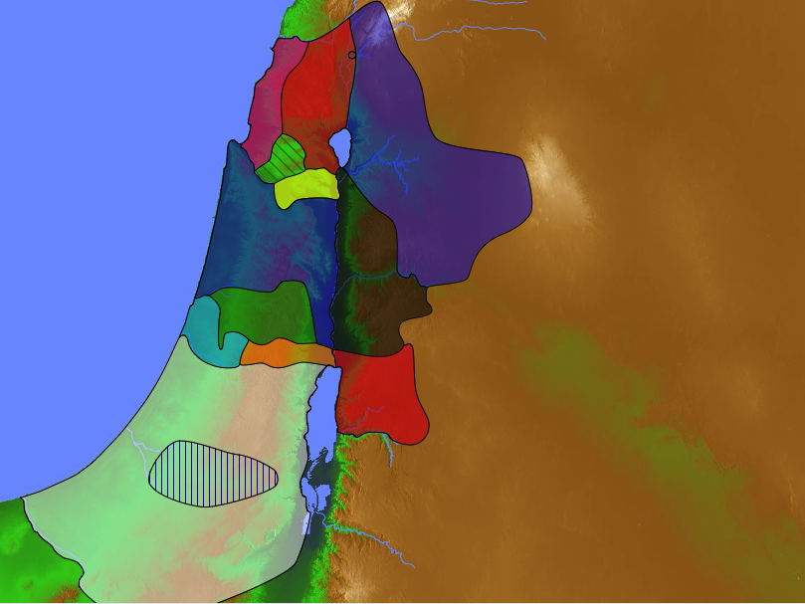
Where did Gideon judge?
Naphtali
180a
Asher
"The Israelites did evil in the LORD's sight. So the LORD handed them over to the Midianites for seven years"
(6:1 NLT).
Zebulun
Manasseh
Issachar
Gideon
Manasseh
Gad
Ephraim
Dan
Benjamin
Reuben
Judah
Simeon
Amalekites
Midianites
Notes:
But the Amalekites joined them. Both of these peoples invaded the land from what we would call the south. Imagine enemies raiding our city and taking all the food for themselves so we don't even have anything to eat! That would be hitting us at the very basic level, and we would have to drastically change our lives.
____________
²The Midianites were so cruel that the Israelites made hiding places for themselves in the mountains, caves, and strongholds. ³Whenever the Israelites planted their crops, marauders from Midian, Amalek, and the people of the east would attack Israel, ⁴camping in the land and destroying crops as far away as Gaza. They left the Israelites with nothing to eat, taking all the sheep, goats, cattle, and donkeys. ⁵These enemy hordes, coming with their livestock and tents, were as thick as locusts; they arrived on droves of camels too numerous to count. And they stayed until the land was stripped bare. ⁶So Israel was reduced to starvation by the Midianites (6:2-6a NLT).

Slide 59
David's Victories
Zobah
140
Phoenicia
Aram
2 Samuel 8
Israel
Ammon
Philistia
Moab
Egypt
Edom

Slide 60
David's New Vassal States
Zobah
140
Phoenicia
Aram
2 Samuel 10
God rewarded David with victory over the Philistines and other nations to show him as a righteous king to whom God had promised an eternal dynasty
(1 Chron 18–20).
Israel
Ammon
Philistia
Moab
Egypt
Edom

Slide 61
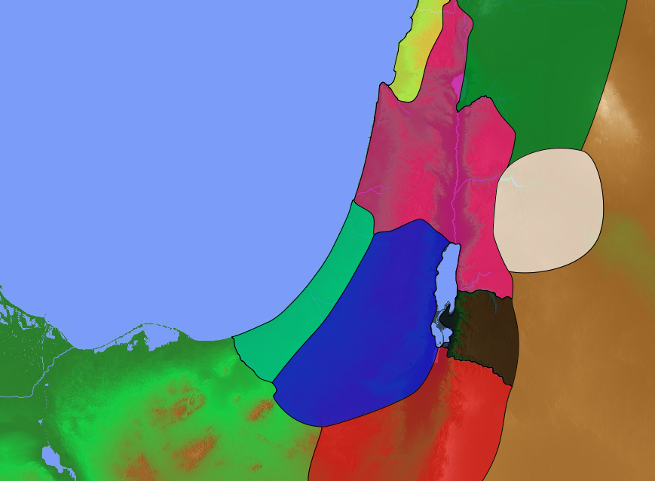
A Shaky Kingdom
140
Phoenicia
Aram
2 Samuel 19
David returned to a restored kingdom in Jerusalem but the north-south division persisted.
Israel
Ammon
Philistia
Judah
Moab
Egypt
Edom

Slide 62
Tribal Loyalties
171
Asher
Naphtali
2 Samuel 19
Zebulun
Manasseh
Issachar
Manasseh
Gad
Ephraim
Dan
Benjamin
Reuben
Judah
Simeon

Slide 63
United Kingdom
140
Phoenicia
Aram
1 Samuel 8–1 Kings 11
Israel
Ammon
Philistia
Moab
Saul's Kingdom in Blue
David Conquered kingdoms in red
Egypt
Edom

Slide 64
United to Divided
Kingdom
1 Kings 12
Israel
Israel
Judah

Slide 65
United to Divided to United Again
1 Kings 11
1 Kings 12
Ezekiel 37:15-23
Israel
Israel
Israel
Judah

Slide 66
Divided Kingdom
140
Phoenicia
Aram
1 Kings 12
Jerooboam received
10 northern tribes
Rehoboam received
2 southern tribes
Israel
Ammon
Philistia
Judah
Moab
Egypt
Edom

Slide 67
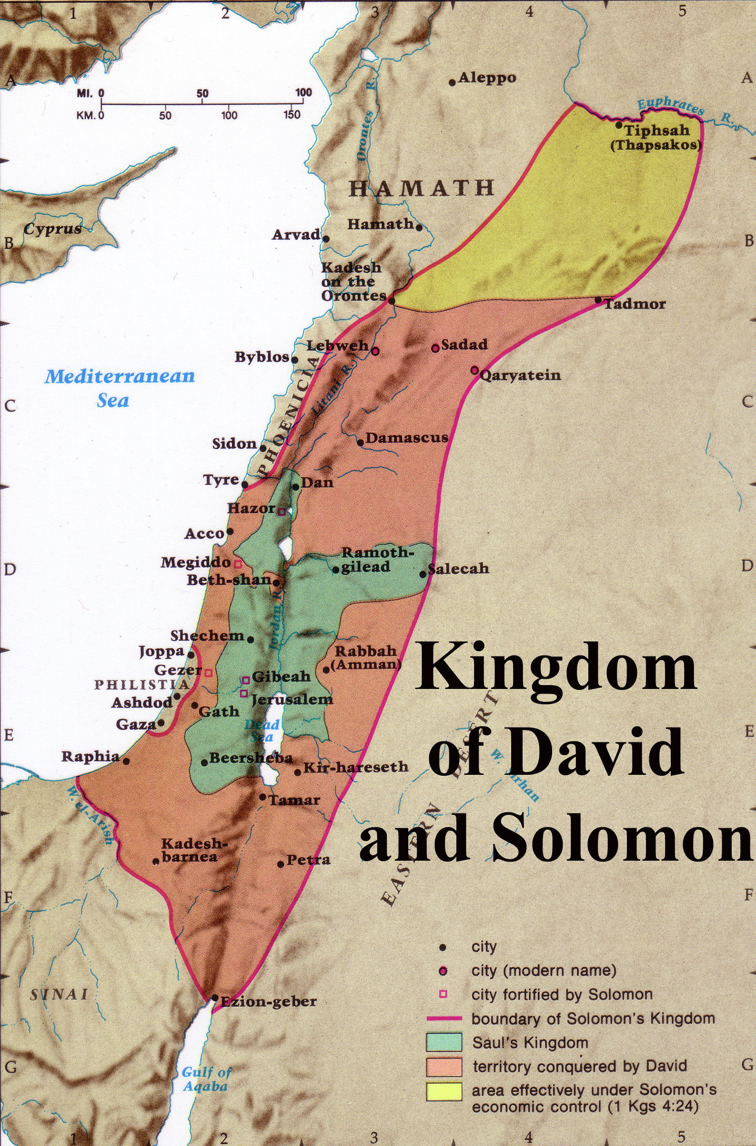
Kingdom of David & Solomon (1 Kings 4:21)
Notes:
God’s promised land stretched northeard from the small wadi of Egypt south in the Sinai to the large Euphrates River in the far north—a HUGE piece of real estate! When today’s boundaries are placed over this land we can see the struggle modern Israel has to claim land from Egypt, Lebanon, Syria and possibly even Jordan on the other side of the Jordan River.

Slide 68
Solomon's Pagan Wives
Sidon
140
1 Kings 11:1 Now King Solomon loved many foreign women. Besides Pharaoh’s daughter, he married women from Moab, Ammon, Edom, Sidon, and from among the Hittites.
Hittite
Israel
Ammon
Moab
Egypt
Edom

Slide 69
Solomon's Pagan Wives
Sidon
140
Hittite
Israel
Ammon
Moab
Egypt
Edom

Slide 70
False Gods Surrounding Israel
Ashtoreth
140
Sidon
"Solomon has abandoned me and worshiped Ashtoreth, the goddess of the Sidonians; Chemosh, the god of Moab; and Molech, the god of the Ammonites"
(1 Kings 11:33a NLT).
Molech
Israel
Ammon
Dagon
Philistia
Chemosh
Moab
Ra, Horus, Amon, etc.
Qos, etc.
Egypt
Edom

Slide 71
Downfalls in 2 Kings
140
Israel to Assyria
Israel
2 Kings 1–17
Judah to Babylon
Judah
2 Kings 17–25

Slide 72
Jordan Rivers & Regions
Lebanon
140
Yarmuk
Let's play a game!
Gilead
Israel
Jabbok
G-A-M-E
Ammon
Philistia
Y-J-A-Z
Arnon
Moab
Egypt
Zered
Edom

Slide 73
To Whom the Prophets Ministered
443
Assyria
Jonah
Phoenicia
Nahum
Aram
Babylon & Persia
Ezekiel
Daniel
Hosea
Israel
Amos
Ammon
Habakkuk
Micah
Judah
Isaiah
Zephaniah
Jeremiah
(Lamentations)
Joel
Haggai
Moab
Zechariah
Malachi
Egypt
Edom
Obadiah

Slide 74
Northern Tribes
(Judges 7:22-25)
171
Naphtali
Asher
Zebulun
Manasseh
Issachar
Manasseh
Gad
Ephraim

Slide 75
Danite Migration
(Judges 18)
171
Asher
Dan
Laish
Naphtali
Zebulun
Manasseh
Issachar
Manasseh
Gad
Ephraim
Dan

Slide 76
Gods of the Nations
Sidon
140
(Baal & Ashtoreth)
Aram
Judges 10:6 NLT
"…They served the images of Baal and Ashtoreth, and the gods of Aram, Sidon, Moab, Ammon, and Philistia…"
(10:6).
Israel
Ammon
Philistia
Moab
Egypt
Edom

Slide 77
Twin Invasions
(Judges 10:8)
"Philistines and the Ammonites…began to oppress them that year. For eighteen years they oppressed all the Israelites east of the Jordan River in the land of the Amorites (that is, in Gilead)" (NLT).
171
Zebulun
Issachar
Manasseh
Manasseh
Gilead
Ammon
Ephraim
Philistines
Benjamin
Judah
Reuben

Slide 78
Eastern Invasions
(Judges 10:9)
171
Zebulun
"The Ammonites also crossed to the west side of the Jordan and attacked Judah, Benjamin, and Ephraim. The Israelites were in great distress" (NLT).
Issachar
Manasseh
Manasseh
Gilead
Ammon
Ephraim
Philistines
Benjamin
Judah
Reuben

Slide 79
Micah’s Home
(Judges 17:1)
171
"There was a man named Micah, who lived in the hill country of Ephraim" (NLT).
Zebulun
Issachar
Manasseh
Manasseh
Gilead
Ephraim
Benjamin
Judah
Reuben

Slide 80
Levite Migration
(Judges 17:7 NIV)
“A young Levite from Bethlehem in Judah…came to Micah’s house in the hill country of Ephraim.”
171
Zebulun
Issachar
Manasseh
Manasseh
Gilead
Ephraim
Benjamin
Bethlehem
Judah
Reuben

Slide 81
Southern Israel
140
Ehud of Benjamin
Gilgal
Judges 3
“After delivering the payment, Ehud started home with those who had helped carry the tribute. ¹⁹But when Ehud reached the stone idols near Gilgal, he turned back” (3:18-19a NLT).
Moab

Slide 82
Judgments on the Nations
Lebanon
140
Aram
Passage
Text
Israel
Ammon
Philistia
Moab
Egypt
Edom

Slide 83
Reversal in Obadiah
140
Edom Over Israel
Israel Over Edom
Judah
1-14
15-21
Edom

Slide 84
Judgment on the 12-Nation Coalition (Isa 13–23)
457
Assyria
Phoenicia
Syria
Israel
Babylon
Judah
Philistia
Moab
Babylon by the Sea
Egypt
Edom
Arabia
Ethiopia
Notes:
The temptation for Ahab in Isaiah's time was to trust in a coalition of other nations to fight Assyria—yet God told them to trust him instead. Why? All these nations would fall to Assyria since God had appointed it. The Assyrians later destroyed the northern nation of Israel during Isaiah’s lifetime—as well as 46 cities of Judah.
In such a time of calamity, whom would Judah trust?

Slide 85
Judgment of the Nations (Jeremiah 46–51)
637
Damascus
(49:23-27)
Babylon
(50–51)
Philistia
(47:1-7)
Elam
(49:34-39)
Ammon (49:1-6)
Moab (48:1-47)
Egypt
(Jer 46)
Edom (49:7-22)
Kedar & Hazor
(49:28-35)

Slide 86
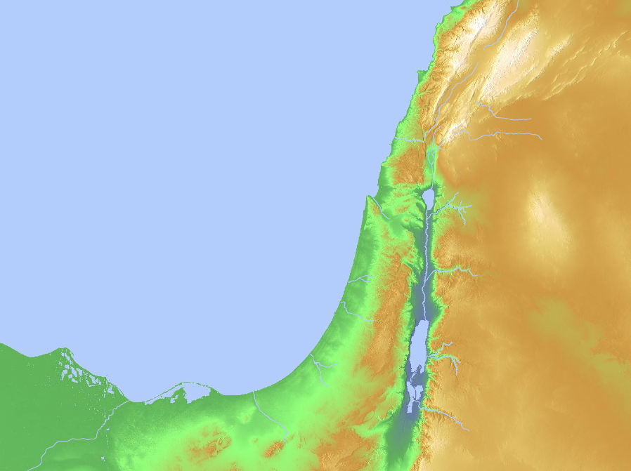
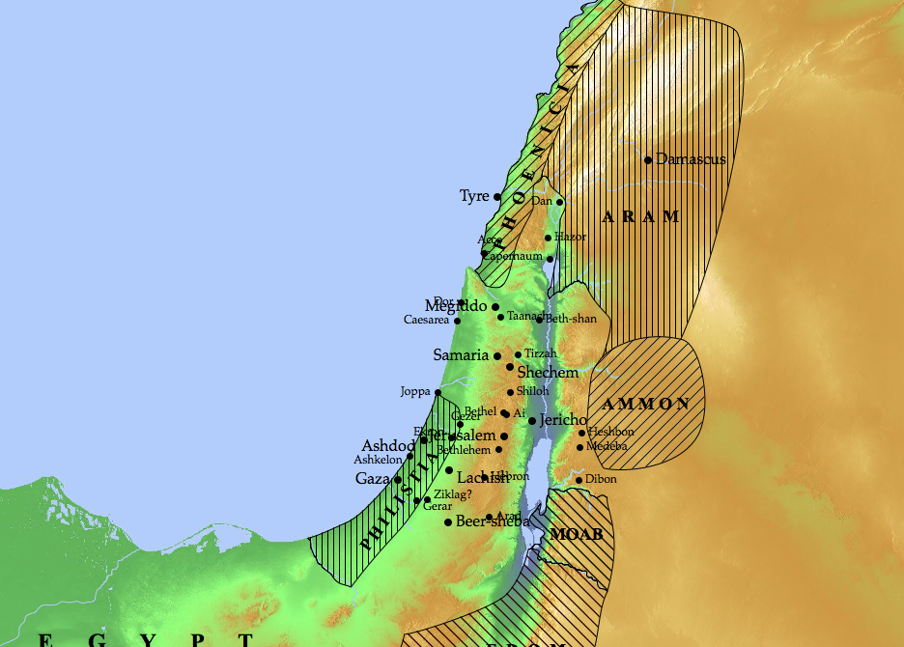
Nations to Be Judged (Ezekiel 25–32)
Sidon
(28:20-26)
Tyre
(26:1–28:19)
Ammon
(25:1-7)
Philistia
(25:15-17)
Moab
(25:8-11)
Egypt
(29–32)
Edom
(25:12-14)
Notes:
God will judge Ammon for rejoicing at the temple’s destruction to show his sovereignty (25:1-7).
God will judge Moab for thinking that Israel was like all of the other nations to show God's sovereignty (25:8-11).
God will judge Edom for avenging Judah to show God's sovereignty (25:12-14).
God will judge Philistia for avenging Judah to show God's sovereignty (25:15-17).
God will judge Tyre so it will never be rebuilt due to its pride in its beauty, power, trade, and leaders to show God's sovereignty (26:1–28:19).
God will judge Sidon for maliciousness against Judah to show his sovereignty by gaining glory in the judgment (28:20-26).
God will judge Egypt by Nebuchadnezzar who will take exiles to Babylon to show God's sovereignty (Ezek 29–32; fulfilled in 571 BC).

Slide 87



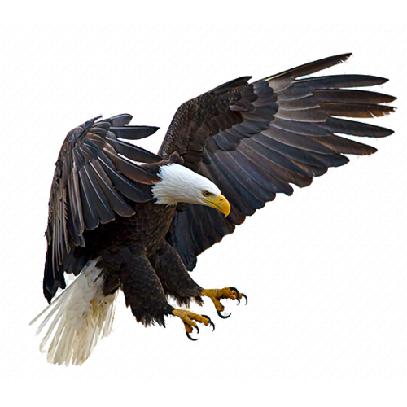
The Eagles and Vine Parable (Ezekiel 17)
Babylon
Jerusalem
Egypt
Notes:
The eagles and vine parable depicted God's judgment for trusting Egypt instead of him, yet even still he would restore them (Ezek 17).
A Story of Two Eagles
Ezek. 17:1 Then this message came to me from the LORD: ² “Son of man, give this riddle, and tell this story to the people of Israel. ³ Give them this message from the Sovereign LORD:
“A great eagle with broad wings and long feathers,
covered with many-colored plumage,
came to Lebanon.
He seized the top of a cedar tree
⁴ and plucked off its highest branch.
He carried it away to a city filled with merchants.
He planted it in a city of traders.
⁵ He also took a seedling from the land
and planted it in fertile soil.
He placed it beside a broad river,
where it could grow like a willow tree.
⁶ It took root there and
grew into a low, spreading vine.
Its branches turned up toward the eagle,
and its roots grew down into the ground.
It produced strong branches
and put out shoots.
⁷ But then another great eagle came
with broad wings and full plumage.
So the vine now sent its roots and branches
toward him for water,
⁸ even though it was already planted in good soil
and had plenty of water
so it could grow into a splendid vine
and produce rich leaves and luscious fruit.
Ezek. 17:9 “So now the Sovereign LORD asks:
Will this vine grow and prosper?
No! I will pull it up, roots and all!
I will cut off its fruit
and let its leaves wither and die.
I will pull it up easily
without a strong arm or a large army.
¹⁰ But when the vine is transplanted,
will it thrive?
No, it will wither away
when the east wind blows against it.
It will die in the same good soil
where it had grown so well.”
The Riddle Explained
Ezek. 17:11 Then this message came to me from the LORD: ¹² “Say to these rebels of Israel: Don’t you understand the meaning of this riddle of the eagles? The king of Babylon came to Jerusalem, took away her king and princes, and brought them to Babylon. ¹³ He made a treaty with a member of the royal family and forced him to take an oath of loyalty. He also exiled Israel’s most influential leaders, ¹⁴ so Israel would not become strong again and revolt. Only by keeping her treaty with Babylon could Israel survive.
Ezek. 17:15 “Nevertheless, this man of Israel’s royal family rebelled against Babylon, sending ambassadors to Egypt to request a great army and many horses. Can Israel break her sworn treaties like that and get away with it? ¹⁶ No! For as surely as I live, says the Sovereign LORD, the king of Israel will die in Babylon, the land of the king who put him in power and whose treaty he disregarded and broke. ¹⁷ Pharaoh and all his mighty army will fail to help Israel when the king of Babylon lays siege to Jerusalem again and destroys many lives. ¹⁸ For the king of Israel disregarded his treaty and broke it after swearing to obey; therefore, he will not escape.
Ezek. 17:19 “So this is what the Sovereign LORD says: As surely as I live, I will punish him for breaking my covenant and disregarding the solemn oath he made in my name. ²⁰ I will throw my net over him and capture him in my snare. I will bring him to Babylon and put him on trial for this treason against me. ²¹ And all his best warriors will be killed in battle, and those who survive will be scattered to the four winds. Then you will know that I, the LORD, have spoken.
Ezek. 17:22 “This is what the Sovereign LORD says: I will take a branch from the top of a tall cedar, and I will plant it on the top of Israel’s highest mountain. ²³ It will become a majestic cedar, sending forth its branches and producing seed. Birds of every sort will nest in it, finding shelter in the shade of its branches. ²⁴ And all the trees will know that it is I, the LORD, who cuts the tall tree down and makes the short tree grow tall. It is I who makes the green tree wither and gives the dead tree new life. I, the LORD, have spoken, and I will do what I said!”
The eagles and vine parable depicted God's judgment for trusting Egypt instead of him, yet even still he would restore them (Ezek 17).

Slide 88
"On January 7, during the tenth year of King Jehoiachin’s captivity [587 BC], this message came to me from the LORD:
²'Son of man, turn and face Egypt and prophesy against Pharaoh the king and all the people of Egypt'"
—Ezekiel 29:1-2 NLT—
Egypt
(29–32)
Notes:
Egypt would be exiled for 40 years due to her violence and pride but then restored to a weak standing among the nations (29:1-16).

Slide 89
Babylon to Conquer Egypt
"Son of man, the army of King Nebuchadnezzar of Babylon fought so hard against Tyre that the warriors’ heads were rubbed bare and their shoulders were raw and blistered. Yet Nebuchadnezzar and his army won no plunder to compensate them for all their work"
(Ezekiel 28:18 NLT).
Tyre
Egypt

Slide 90
Babylon to Conquer Egypt
"Therefore, this is what the Sovereign LORD says: I will give the land of Egypt to Nebuchadnezzar, king of Babylon. He will carry off its wealth, plundering everything it has so he can pay his army. ²⁰ Yes, I have given him the land of Egypt as a reward for his work, says the Sovereign LORD, because he was working for me when he destroyed Tyre"
(Ezekiel 28:18-20 NLT).
Tyre
Egypt

Slide 91
Judgment of the Nations (Zephaniah 2:4-15)
637
Assyria
Philistia
Moab
Edom
Ethiopia

Slide 92
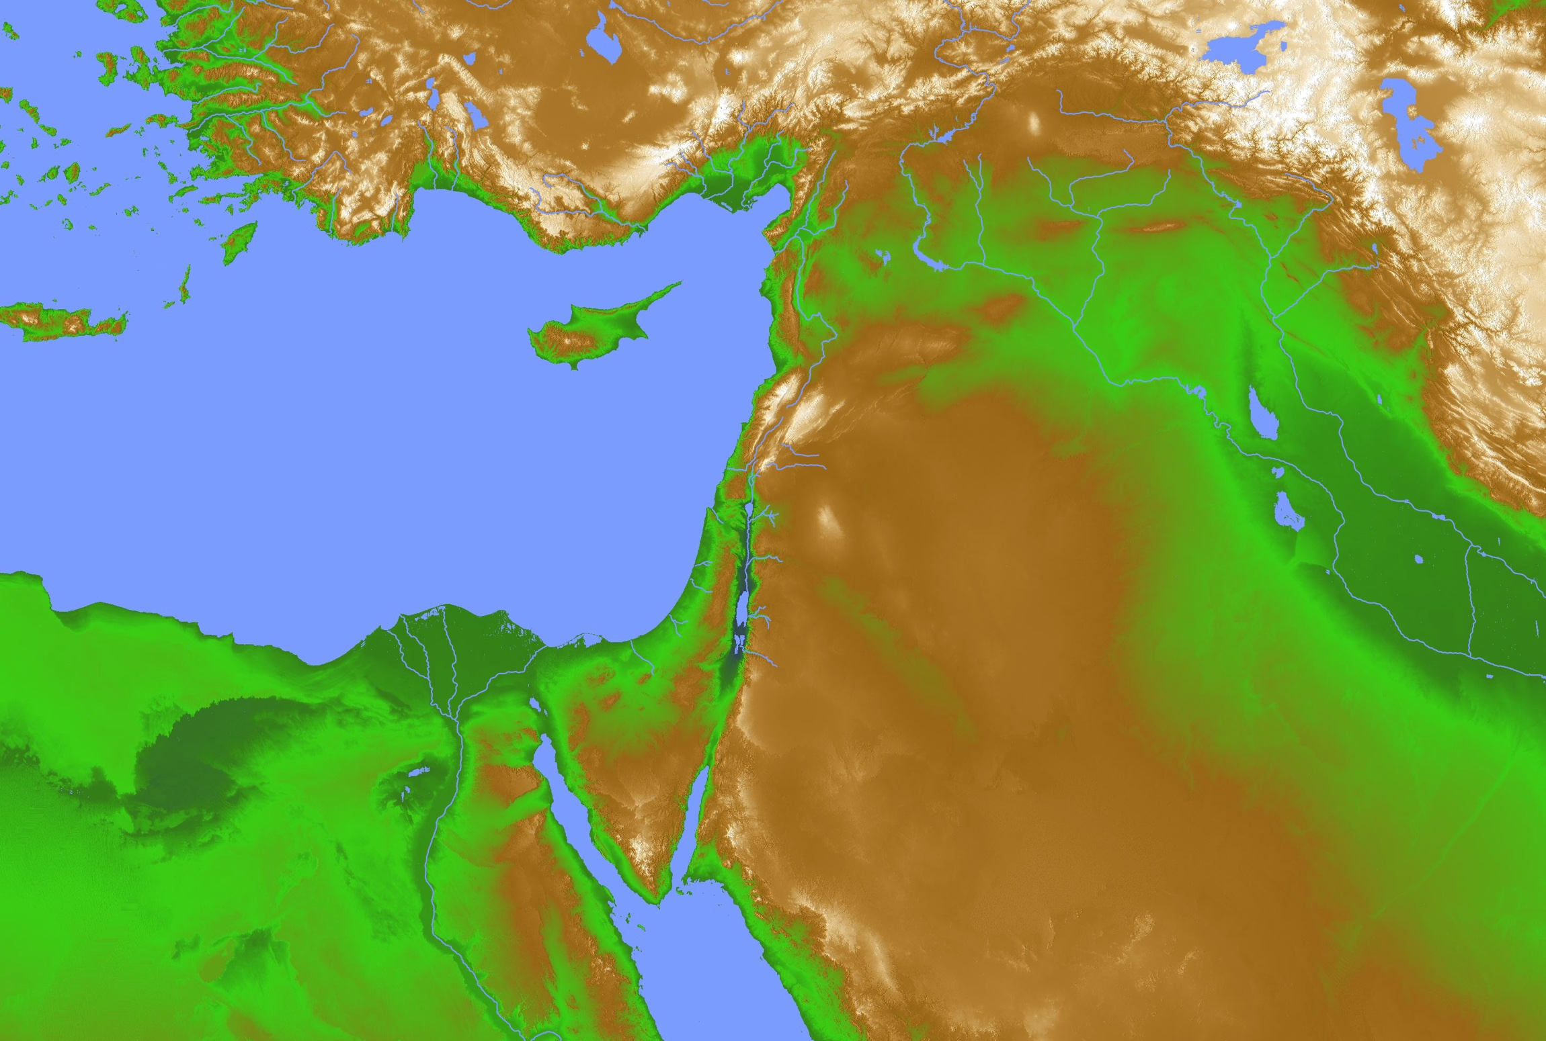
Egypt and Allies Destroyed
Lydia
"…The land of Ethiopia will be ravished.
⁵ Ethiopia, Libya, Lydia, all Arabia,
and all their other allies
will be destroyed in that war."
(Ezekiel 30:4-5 NLT).
Libya
Arabia
Egypt
Ethiopia

Slide 93
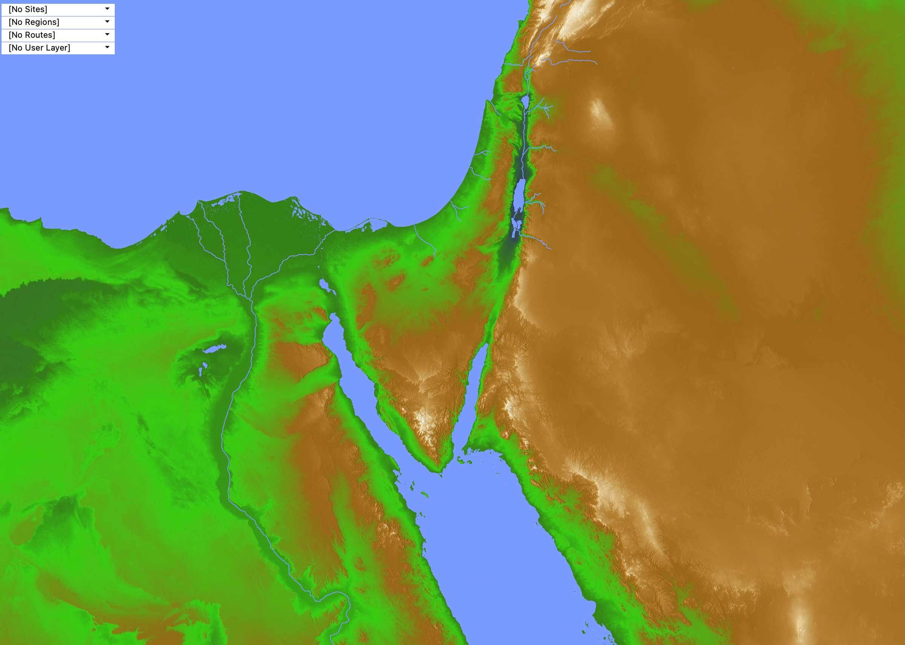
Egypt and Nearby Nations
Libya
Egypt
Arabia
Ethiopia

Slide 94
Judgments
Hamath
“This is the message from the LORD against the land of Aram and the city of Damascus, for the eyes of humanity, including all the tribes of Israel, are on the LORD. ²Doom is certain for Hamath, near Damascus, and for the cities of Tyre and Sidon, though they are so clever. ³Tyre has built a strong fortress
and has made silver and gold as plentiful as dust in the streets! ⁴But now the LORD will strip away Tyre’s possessions and hurl its fortifications into the sea, and it will be burned to the ground.”
Damascus
Sidon
Tyre
Aram
Israel
Zechariah 9:1-4 NLT

Slide 95
Judgment of the Nations (Zephaniah 2:4-15)
637
Assyria
Philistia
Moab
Edom
Ethiopia

Slide 96
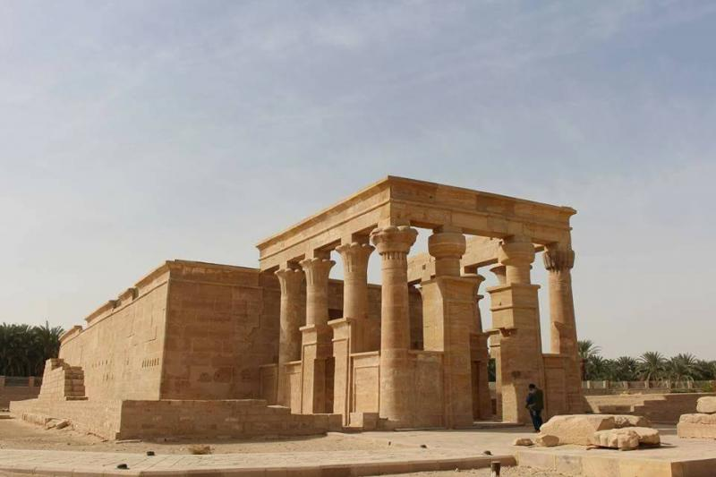
Kharga
"﻿In Egypt, under Cambyses and especially Darius I, the Persian kings sought to patronize the local cults. For Cambyses the high dignitary Udja-Hor-resenet acted in the role of an Egyptian adviser, and enlisted his interest in the temple of the goddess Neith of Sais. Darius I in turn was served by this same dignitary, sanctioned building work on Egyptian temples, and caused to be built a whole new temple at Hibis in the Great Oasis (Kharga)."
K. A. Kitchen, On the Reliability of the Old Testament (Grand Rapids: Eerdmans), Kindle Edition loc. 1859 of 14459
Temple at Hibis in the Great Oasis (Kharga)

Slide 97
Bible Lands Blank Map
The Roman Empire
© EBibleTeacher.com

Slide 98
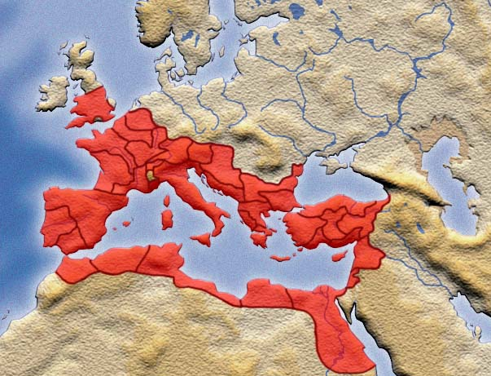
The Roman Empire

Slide 99
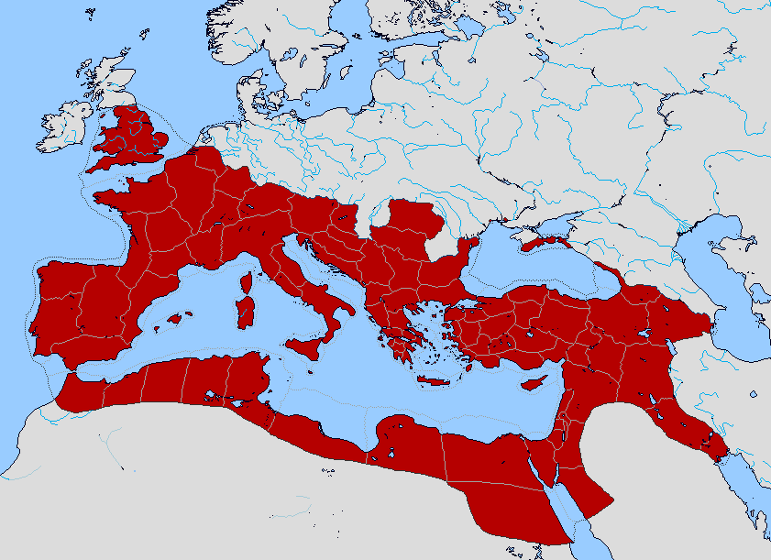
Bible Lands Blank Map
The Roman Empire
© https://www.deviantart.com/sharklord1/art/Alt-Roman-Empire-Provinces-701148110

Slide 100
Bible Lands Blank Map
The Roman Empire
"But you shall receive power when the Holy Spirit has come upon you; and you shall be My witnesses both in Jerusalem, and in all Judea and Samaria, and even to the remotest part of the earth" (Acts 1:8 NAU).
"remotest part"
Samaria
Jerusalem
Judea
© https://www.deviantart.com/sharklord1/art/Alt-Roman-Empire-Provinces-701148110

Slide 101
Bible Lands Blank Map
Paul’s Post-Acts Journey
142
Rome
Macedonia
Spain
Ephesus
1 Timothy
Crete
© https://www.deviantart.com/sharklord1/art/Alt-Roman-Empire-Provinces-701148110

Slide 102
NT Israel
(AD 67-68)
Jerusalem

Slide 103
JESUS RAISES LAZARUS
(JOHN 11)
SAMARIA
PEREA
River Jordan
Jerusalem
Bethany
0 5 MILES
JUDEA
Salt Sea
0 8 KM
Notes:
Jews at the time of Jesus hated the Samaritans so much that they did not travel northward from Jerusalem through Samaria to get to the north. Instead, they traveled east through Bethany on the other side of the Mount of Olives and straight across the Jordan River so as to totally bypass Samaria. Bethany was the hometown of Lazarus and he is sisters, Mary and Martha.
_______
LC-06-Preparation of the Disciples-73
NS-04-John1-11-slide 467

Slide 104
JESUS RAISES LAZARUS
(JOHN 11)
SAMARIA
PEREA
River Jordan
Jerusalem
Bethany
0 5 MILES
JUDEA
Salt Sea
0 8 KM
Notes:
Jesus received news that Lazarus was sick while Jesus was across the River Jordan. After he waited four days, he then headed toward Bethany.
_______
LC-06-Preparation of the Disciples-75
NS-04-John1-11-slide 476, 478

Slide 105


Places Mentioning Elders
elders = overseers = bishops = pastors
55
Jerusalem (AD 47):
NIV Acts 11:30 This they did, sending their gift to the elders by Barnabas and Saul.
Ephesus (AD 57):
NIV Acts 20:17 From Miletus, Paul sent to Ephesus for the elders of the church.
Galatia (AD 48):
NIV Acts 14:23 Paul and Barnabas appointed elders {or Barnabas ordained elders; or Barnabas had elders elected} for them in each church
Crete (AD 66):
NIV Titus 1:5 The reason I left you in Crete was that you might straighten out what was left unfinished and appoint {or ordain} elders in every town, as I directed you.
Philippi (AD 62):
NIV Philippians 1:1 Paul and Timothy, servants of Christ Jesus, To all the saints in Christ Jesus at Philippi, together with the overseers and deacons:
Pontus, Galatia, Cappadocia, Asia & Bithynia (AD 64)
NIV 1 Peter 5:1 To the elders among you, I appeal as a fellow elder… (cf. 1:1)

Slide 106
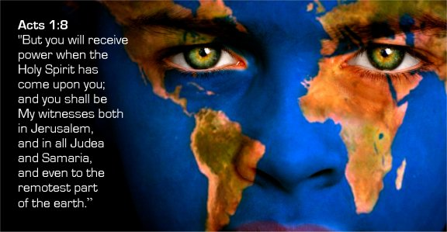
“…you shall be my witnesses”
Notes:
So what was the commission for the disciples (8)?
They were NOT to preach.
They were NOT to teach.
They were simply to WITNESS what they experienced. Isn’t that freeing?

Slide 107
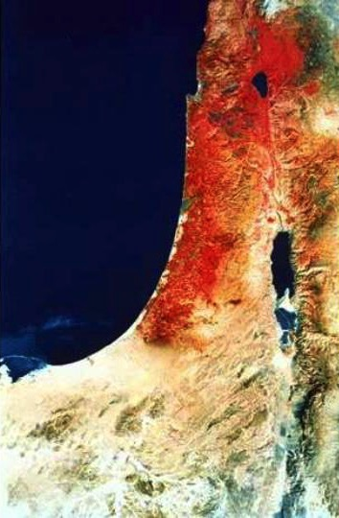
Acts 1:8 NAU
"remotest part"
"But you shall receive power when the Holy Spirit has come upon you; and you shall be My witnesses both in Jerusalem, and in all Judea and Samaria, and even to the remotest part of the earth."
Samaria
Jerusalem
Judea

Slide 108
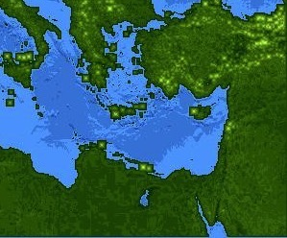
Jews at Pentecost––Acts 2:9-11
132
Rome (13)
PONTUS (7)
CAPPADOCIA (6)
ASIA (8)
PHRYGIA (9)
Parthia (1)
PAMPHILIA (10)
Mesopotamia (4)
CRETE (14)
Media (2)
Elam (3)
Jerusalem
CYRENE (12)
JUDEA (5)
ASIA––Roman Empire Provinces
Media––Parthian Empire Provinces
EGYPT (11)
Rome––Cities
CRETE––Islands
ARABIA (15)
Miles
0
200
400
600
800
1000
(1) (2) (3) etc. indicate sequence in Acts 2:9-11
Kms
0
300
600
900
1200
1500
Notes:
Jews numbered 40,000 in Rome during the reign of Augustus (30 BC to AD 14), so this was a sizable minority. We do not know for sure who actually started the church at Rome, but it likely was some of these Jews who returned to Rome after receiving the Spirit at Pentecost in Jeruslem. They, in turn, led Gentiles in Rome to faith as well.

Slide 109
God will restore Israel to the land twice
“In that day the LORD will reach out his hand a second time to reclaim the remnant that is left of his people from Assyria, from Lower Egypt, from Upper Egypt, from Cush, from Elam, from Babylonia, from Hamath, and from the islands of the sea”
(Isaiah 11:12 NIV).
Assyria
Babylonia
Islands of the Sea
Elam
Israel
Lower Egypt
Upper Egypt
Cush

Slide 110

Where did these Jews live?
256
Rome?
Assyria
Babylonia
Hamath
Israel?
Lower Egypt

Slide 111
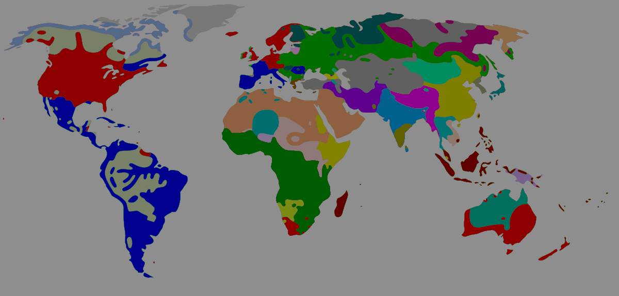
Main Idea of Acts 2
The Spirit put you into Christ’s body to reach the nations

Slide 112

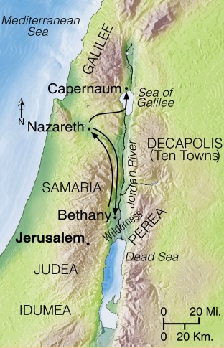
Progress Reports
125
End of the Earth
Key Verse: 1:8
2:47b
6:7
8:40
9:31
12:24
16:5
19:20
28:30-31
1:1–6:7
6:8–8:40
Acts 9–28
Why end this way?
Adapted from Stanley D. Toussaint, BKC; Jeremy Chew, EAST

Slide 113
Paul Called Luke's Gospel “Scripture” within 5 years!
For the Scripture says, “Do not muzzle the ox while it is treading out the grain,” and “The worker deserves his wages” (1 Timothy 5:18).
Macedonia
Paul Wrote 1 Timothy
AD 62
Caesarea
Luke Written
AD 57-59
Stay in that house, eating and drinking whatever
they give you, for
the worker deserves his wages… (Luke 10:7)
Notes:
Look how EARLY certain books were deemed to be Scripture!

Slide 114
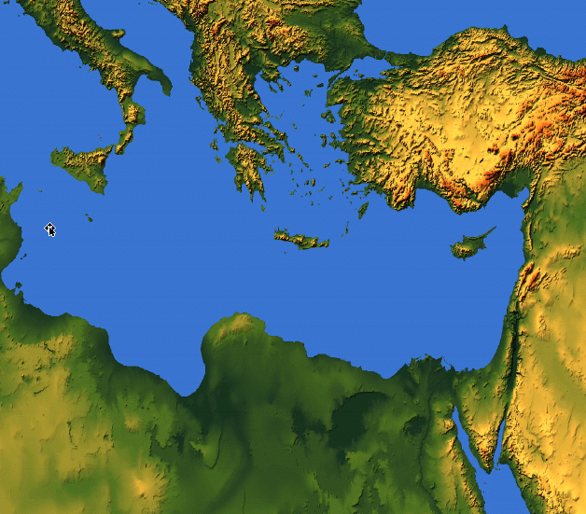

Paul & Barnabas
Tarsus
(Acts 11:25)
First Journey
(Acts 13–14)
Antioch
Jerusalem Council
(Acts 15:1-35)
Jerusalem
(Acts 9:27)
Notes:
The men, as you could tell from our Scripture reading, are Paul and Barnabas.
These two men both walked with God and with one another very closely.
• Barnabas had reached out to Paul when Paul came to Jerusalem as a new Christian. The church shunned Paul, not believing that he had really converted from his previous life of persecuting Christians—but Barnabas stuck with him.
• When the church at Antioch in the north needed assistance, Barnabas traveled back to Paul’s hometown to bring him to Antioch as a teacher.
• Then they traveled for two years as missionaries to plant at least ten churches. In fact, they had remained united through tremendous obstacles and brutal persecutions.
• In Acts 15:1-35, Paul and Barnabas were united against the false teaching on grace by the believing Pharisees in Jerusalem.
But in Acts 15:36-41 we see their own unity fractured. In fact, they disagreed on a relatively minor matter.

Slide 115
Apostles Opposed in Acts 16–19
Thessalonica
Philippi
Berea
Athens
Ephesus
Corinth
Notes:
Before the riot in Ephesus in Acts 19:23-41, Christianity had already shown itself peaceful a number of times.
Owners of a slave girl in Philippi whom Paul and Silas had released from a demon had them beaten, flogged, and imprisoned—but they prayed and sang in prison, which is not exactly rioting behavior (16:16-25). These men caused no riot—rather, they were the victims of the riot caused by others!
Jews in Thessalonica jealous of Paul convincing some fellow Jews that Jesus was Messiah, accused Paul and Silas of causing trouble all over the world (17:6), recruited bad characters and caused a riot (17:2-5). These men caused no riot—rather, they were the victims of the riot caused by others!
After kicking them out of Thessalonica, these Jews even traveled to Berea and agitated the crowds so the apostles got kicked out of Berea too (17:13-14). These men caused no riot—but they were victims of the riot caused by others!
At Athens, Epicurean and Stoic philosophers ridiculed Paul publicly, but Paul gave a reasoned defense. Paul caused no riot—rather, he was the victim of the sneering of others (17:18, 32).
In Corinth, Jews abused Paul (18:6), but Paul only shook out his clothes in response. Paul caused no abuse to them—rather, his friend Sosthenes was the victim of their abuse right in front of the government official (18:17).
At Ephesus, Jews publicly maligned Paul and expelled him from the synagogue (19:9). Paul healed people and caused no commotion, but a demon beat seven sons of a Jewish priest did (19:16)!

Slide 116
Jews lived throughout the Roman Empire
256
Thessalonica
Rome
Asia Minor
Corinth
Cypress
Israel
Cyrene
Alexandria

Slide 117
Where did these Jews live?
256
Rome?
Asia Minor?
Cypress?
Israel?
Cyrene?

Slide 118
Where did these Jews live?
256
Rome
Israel

Slide 119
From where to where?
219
Macedonia
Ephesus

Slide 120
1-2 Thessalonians
219
Thessalonica
Corinth

Slide 121
The Aegean Sea
Philippi
Thessalonica
Berea
Athens
Ephesus
Corinth

Slide 122
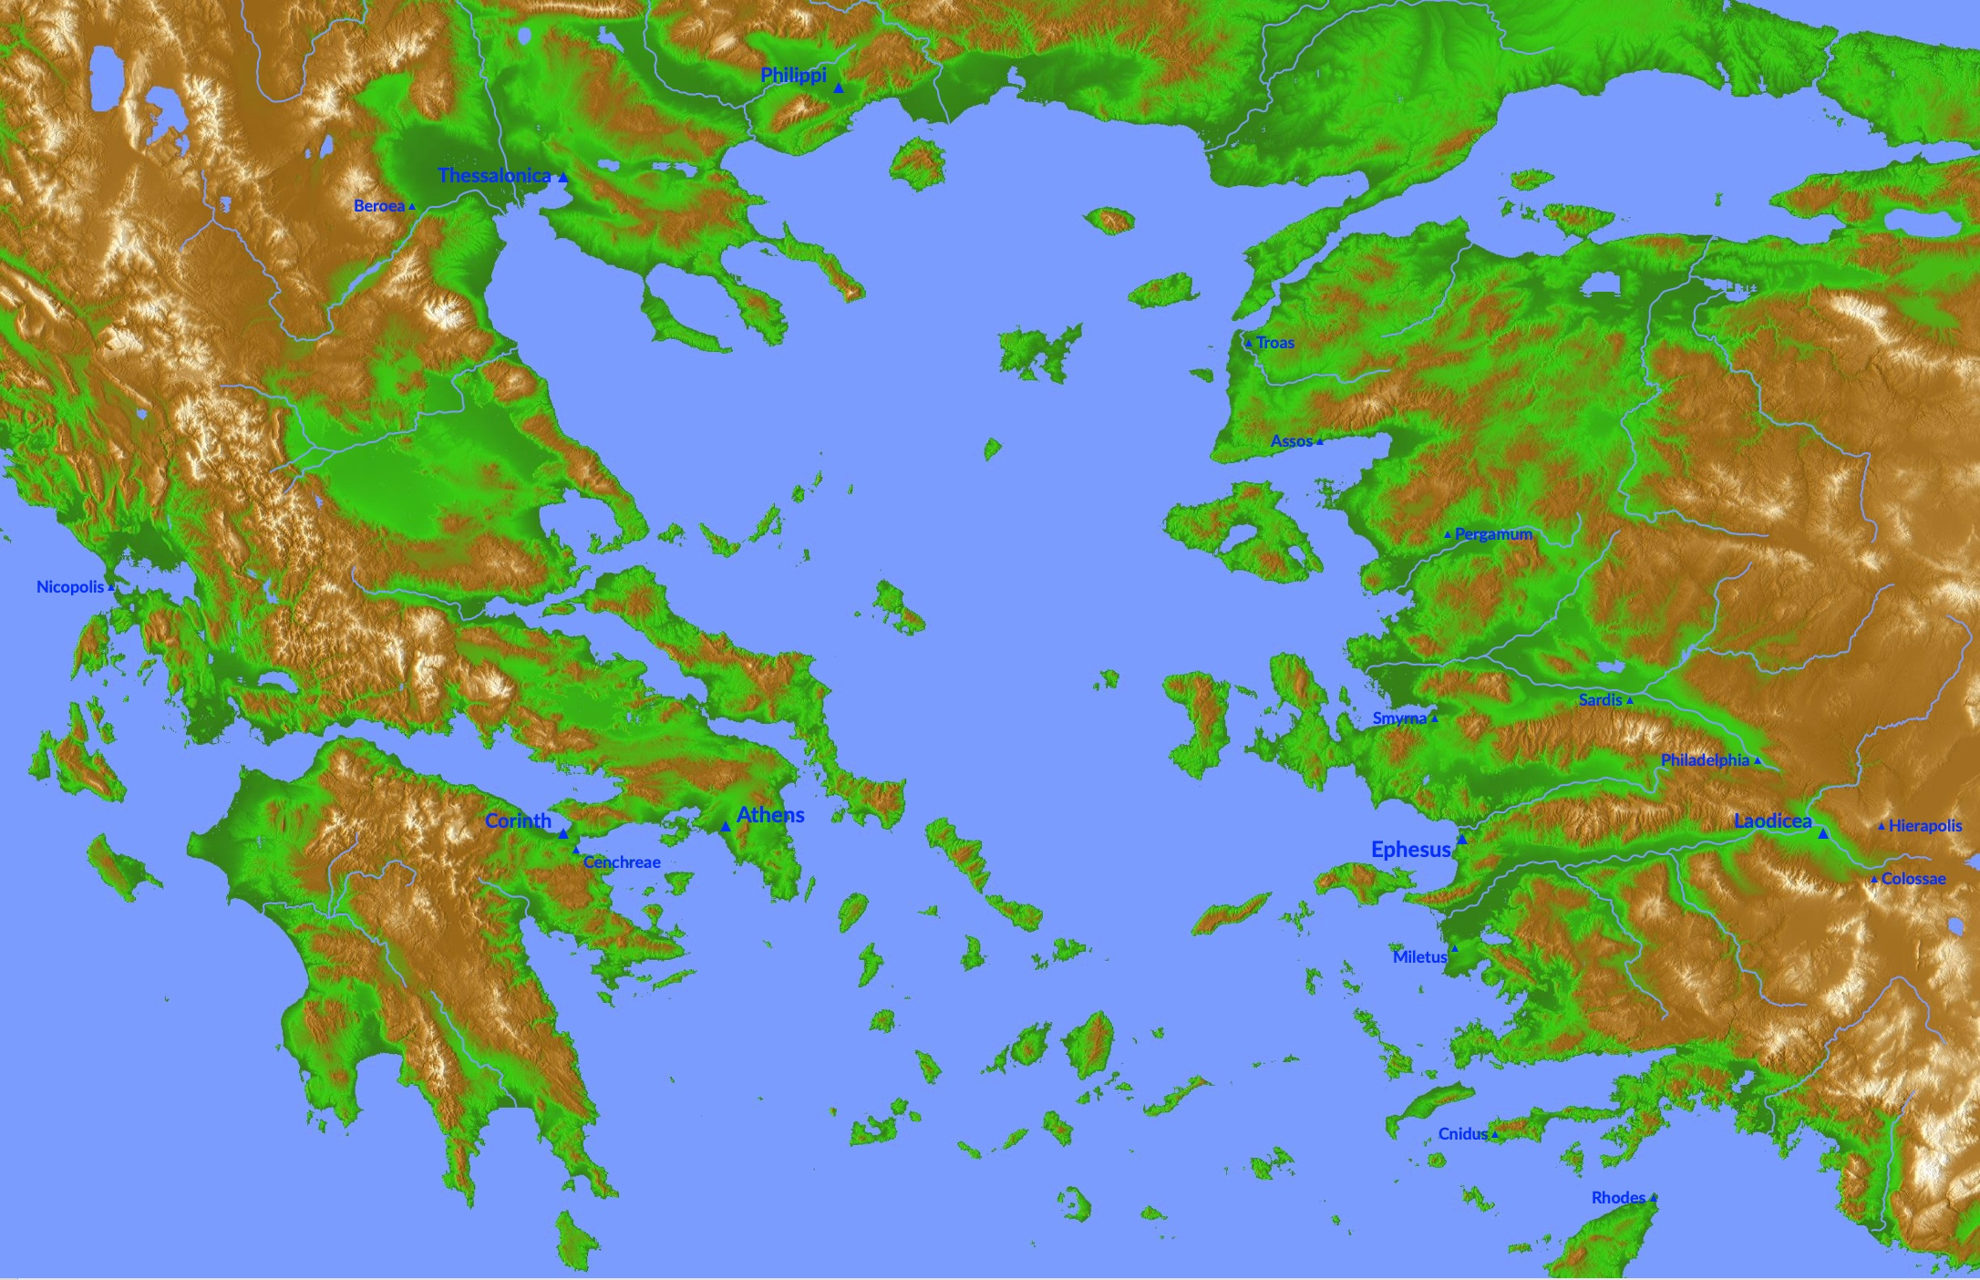
The Aegean Area (With Cities)
Philippi
Thessalonica
Berea
Athens
Ephesus
Corinth

Slide 123
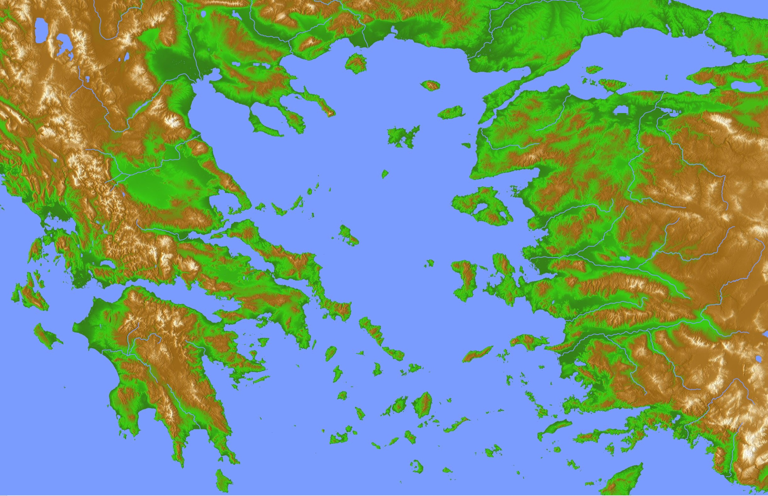
The Aegean Area
Philippi
Thessalonica
Philippi
Berea
Troas
Pergamum
Nicopolis
Sardis
Smyrna
Athens
Hierapolis
Laodicea
Ephesus
Corinth
Colossae
Cnidus
Rhodes

Slide 124
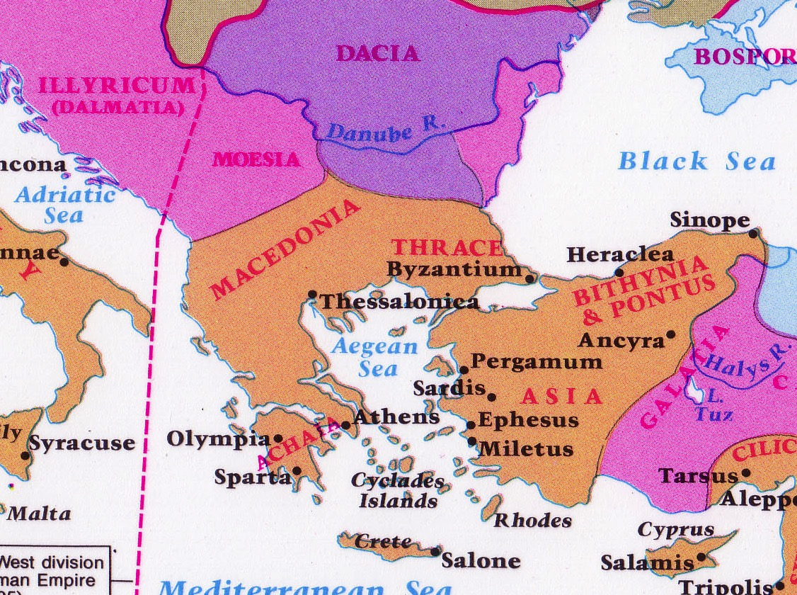
Philosophies at Athens
Athens
Corinth
Notes:
Paul addressed this issue to some people who doubted the resurrection.
They lived in ancient Corinth—a seaport city where a lot of ideas floated around.

Slide 125
The Aegean Area
Athens
Corinth
Notes:
Paul addressed this issue to some people who doubted the resurrection.
They lived in ancient Corinth—a seaport city where a lot of ideas floated around.

Slide 126
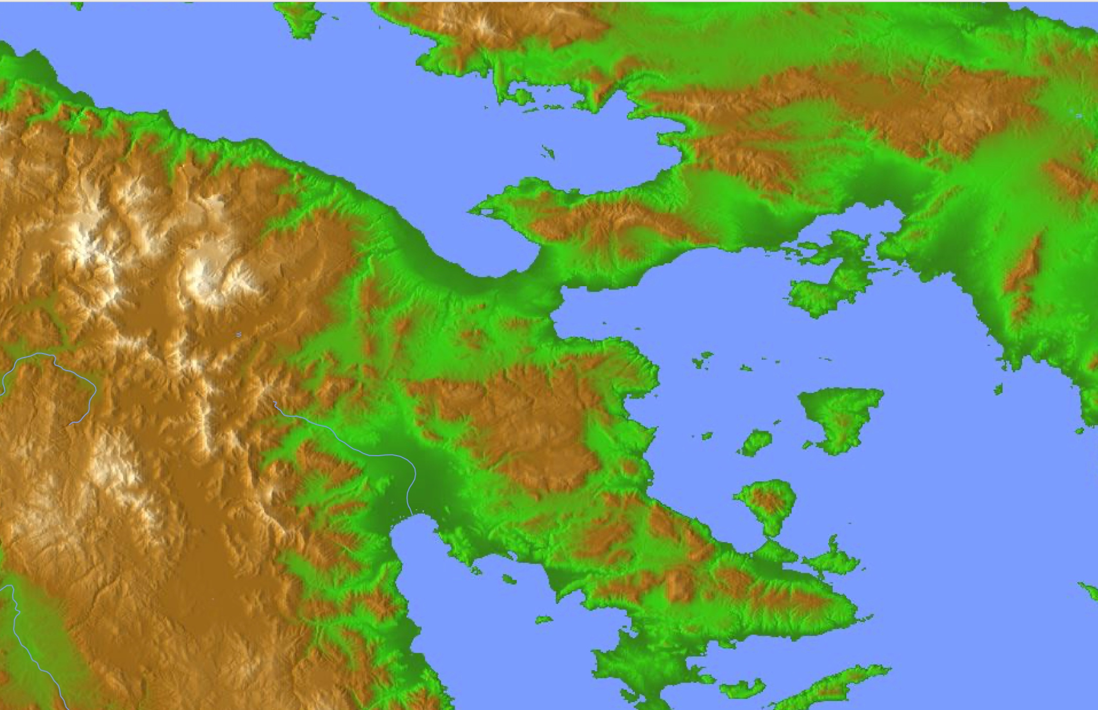
The Corinthian Isthmus
Athens
Corinth
Cenchrea
Notes:
Paul addressed this issue to some people who doubted the resurrection.
They lived in ancient Corinth—a seaport city where a lot of ideas floated around.

Slide 127
Israel & Egypt
Israel
"In that day the mountains will drip with sweet wine,
and the hills will flow with milk.
Water will fill the streambeds of Judah,
and a fountain will burst forth from the LORD’s Temple,
watering the arid valley of acacias.
¹⁹But Egypt will become a wasteland
and Edom will become a wilderness,
because they attacked the people of Judah
and killed innocent people in their land"
(Joel 3:18-19 NLT).
Egypt

Slide 128
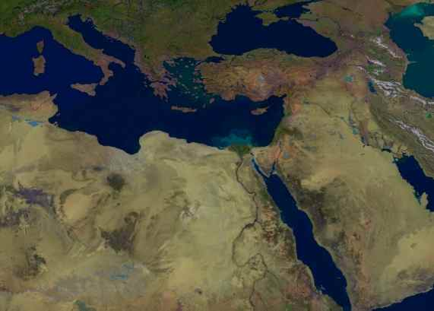
From where to where?
219
Macedonia
Jerusalem

Slide 129
Which peoples?
219
West
(Daniel 11:30)
North
(Daniel 11:6)
Israel
South
(Daniel 11:5)
East
(Judges 6:3)

Slide 130
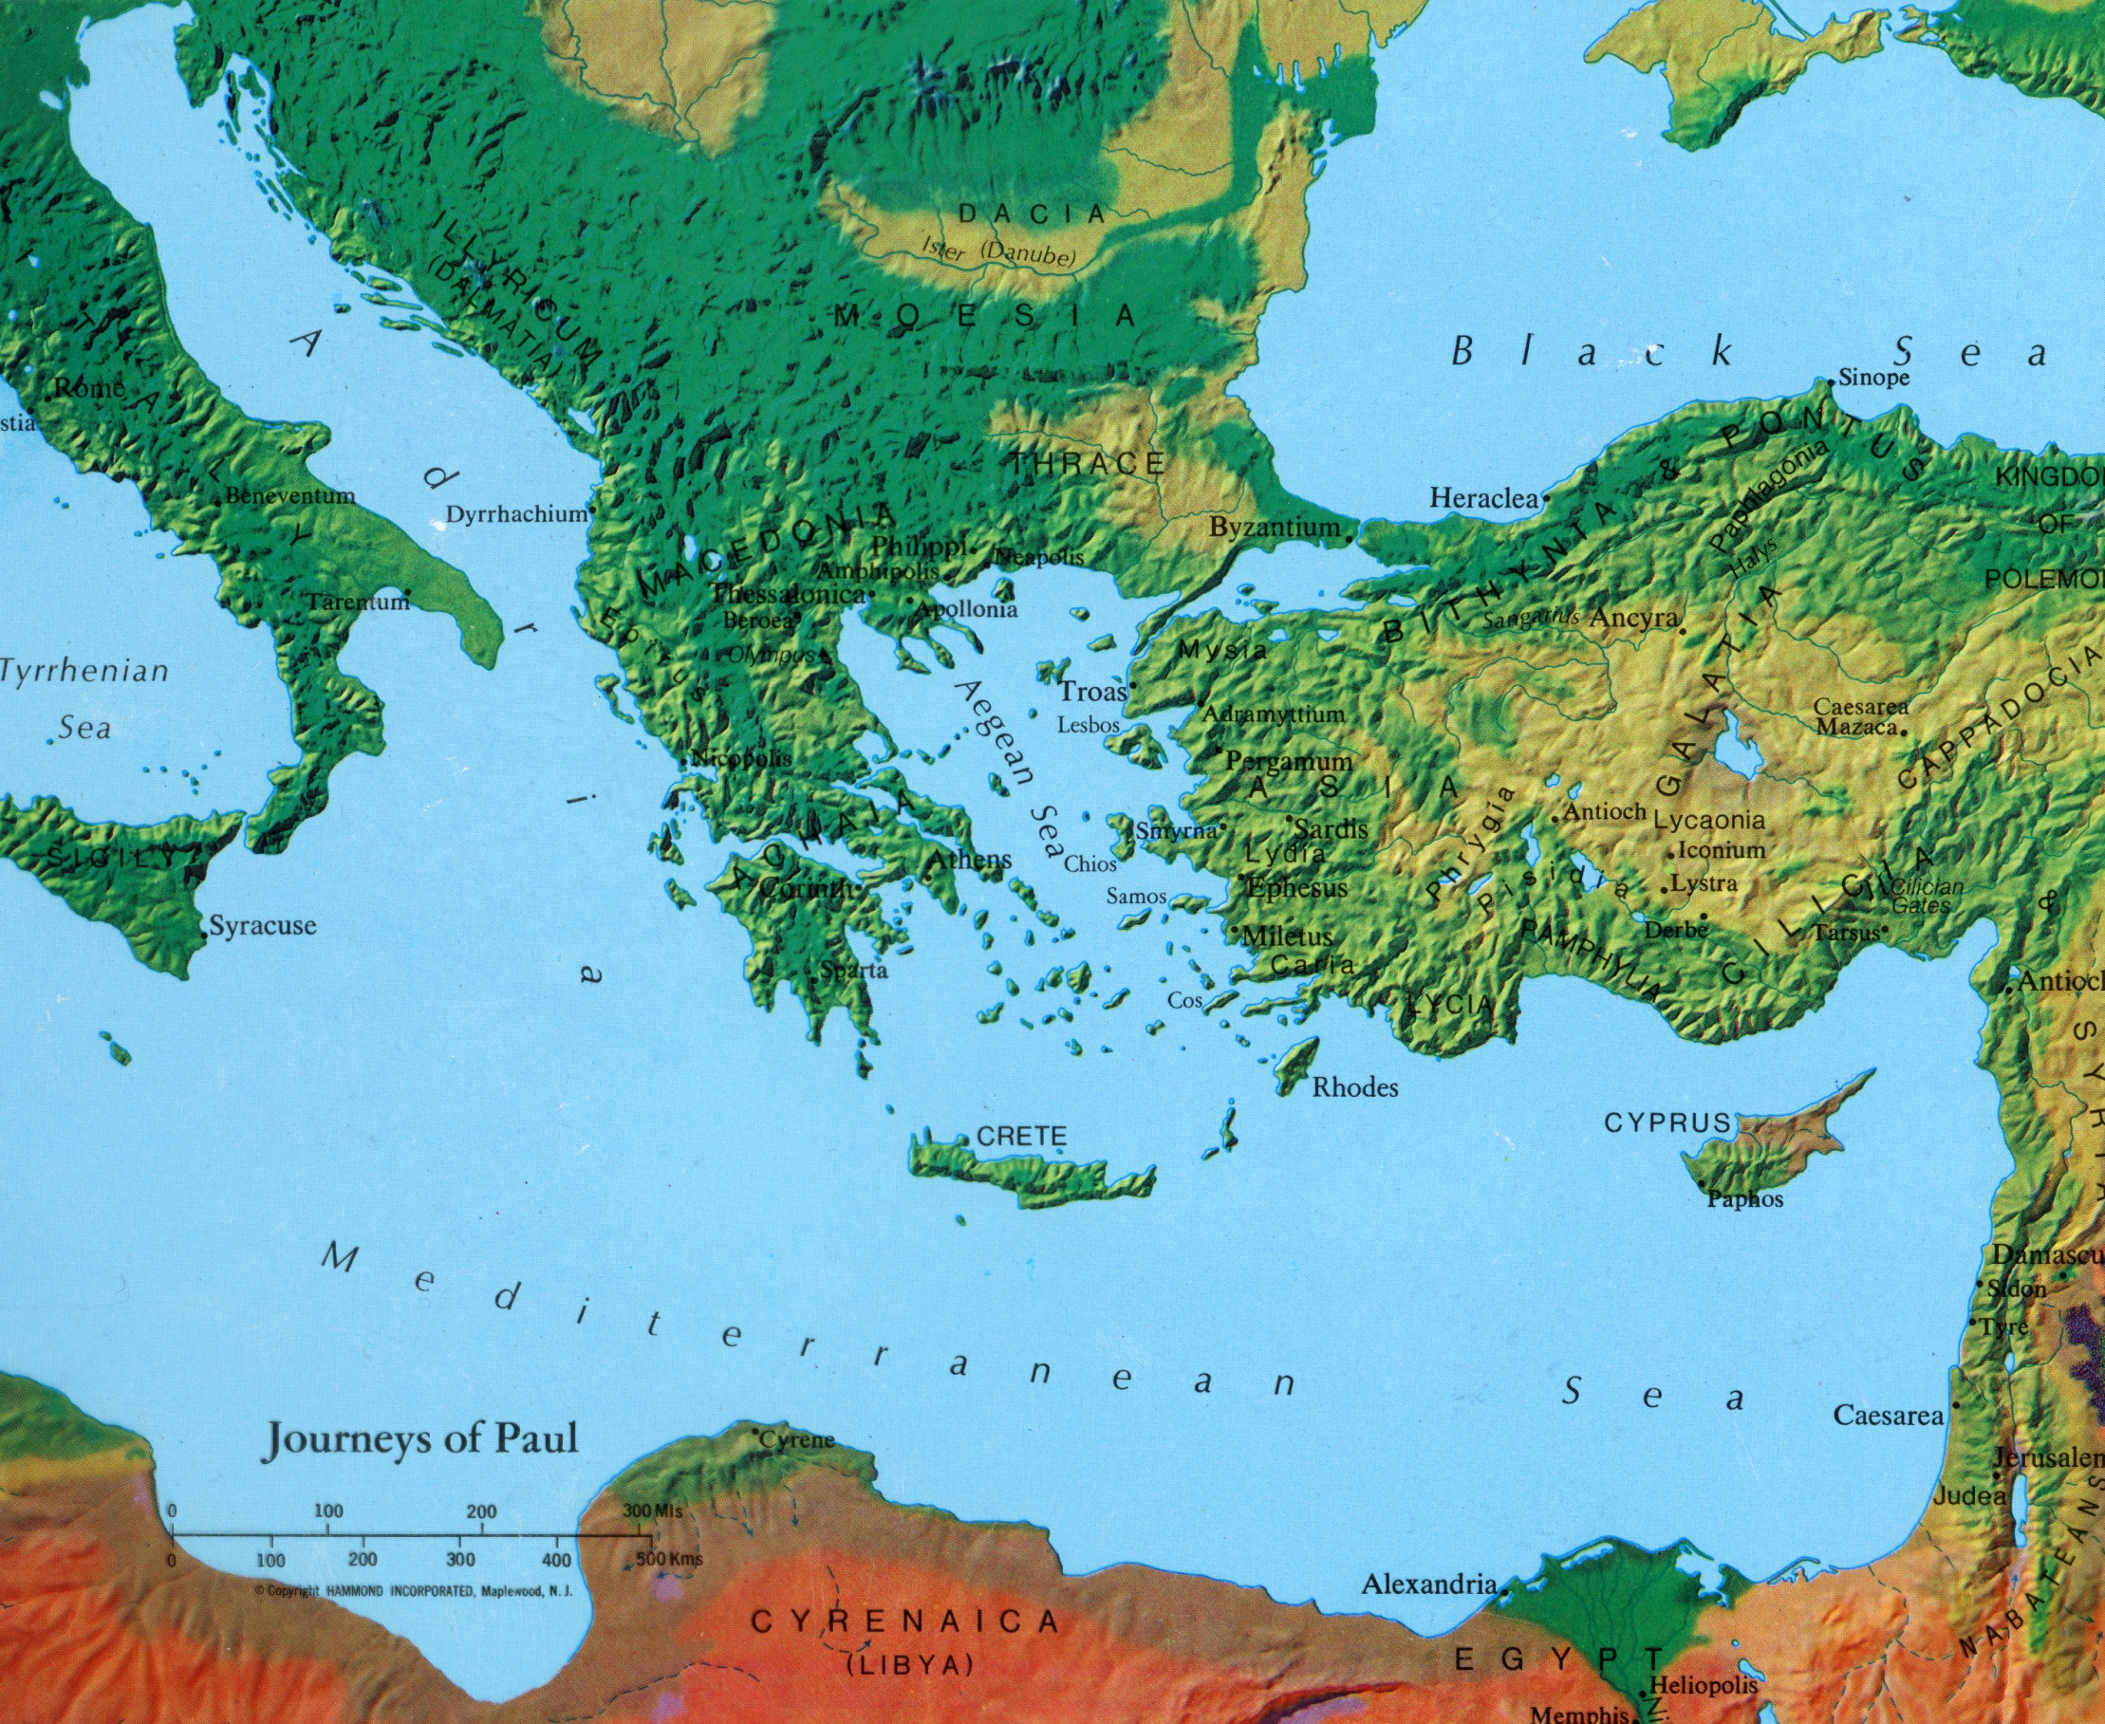
Journeys of Paul

Slide 131

Asia Minor in AD 95
345
Adramyttium
Aezani
Cyme
Erythrae
Eumenia
Lebedus
Colophon
Nysa
Hierapolis
Trailes
Heraclea
Aphrodisias
Colossae
Alabanda
Patmos
Miletus
Notes:
In AD 95 John was exiled to the lonely island of Patmos out in the Adriatic Sea. Jesus Christ had a revelation of comfort to the suffering believers of Asia Minor, but how could this message reach them?

Slide 132
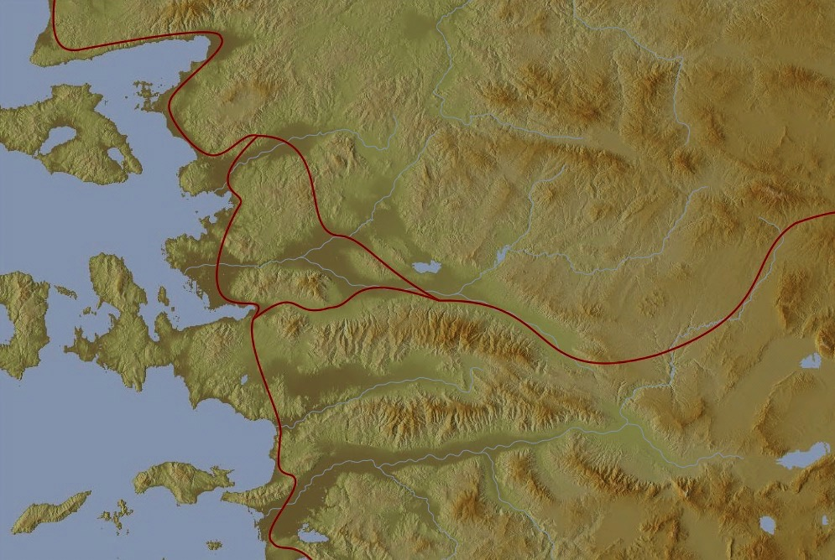

The 7 Churches (Rev. 2–3)
345
Adramyttium
Aezani
Pergamum
Thyatira
Cyme
Erythrae
Sardis
Smyrna
Eumenia
Philadelphia
Lebedus
Colophon
Ephesus
Nysa
Laodicea
Hierapolis
Trailes
Heraclea
Aphrodisias
Colossae
Alabanda
Patmos
Miletus
Notes:
Jesus designed a brilliant strategy by having his revelation sent to capital of the province, Ephesus. It included an individual letter to Ephesus, as well as letters to 6 other key churches. The Ephesians copied the entire book of Revelation, though, and sent the original to the next city, Smyrna. Smyrna then made their own copy and sent the original to Pergamum, which lay on the main road to the north. This city then sent the prophecy to Thyatira, which sent it to Sardis, then Philadelphia, and finally to Laodicea.

Slide 133
The 7 Churches (Rev. 2–3)
345
Pergamum
Thyatira
Sardis
Smyrna
Philadelphia
Ephesus
Laodicea
Notes:
These 7 churches were neither the largest, nor the most influential cities in Asia Minor. However, they were strategically located on a key highway that linked them all.
[Animate} From their own locations we understand that they also copied the prophecy and sent these copies to other churches near them.

Slide 134

Ephesus was the capital of Asia
176

Slide 135
Modern Middle East Nations
27
Terry Hall, Bible Panorama, 49
Turkey
Russia
Syria
Cyprus
Iran
Lebanon
Iraq
Mediterranean Sea
Jordan
Israel
Saudi Arabia
Kuwait
Egypt

Slide 136

How could God get 15 million Jews back to the land?
Israel

Slide 137

Modern Middle East Nations
27
Turkey
Russia
Syria
Cyprus
Iran
Lebanon
Iraq
Mediterranean Sea
Jordan
Israel
Saudi Arabia
Kuwait
Egypt

